Slide 1
Application Delivery Fundamentals 2.0 B:
Groovy
Parameswari Ettiappan

Slide 2
Goals
Groovy Fundamentals
Object-Oriented Programming In Groovy
Groovy Collections
Closures in Groovy
Groovy Control Structures
Miscellaneous Groovy operators
Unit Testing in Groovy
Abstract Syntax Tree (AST) Transformations

Slide 3
Goals
Database Access with Groovy
The Spring Framework
RESTful web services
The Gradle Build Tool

Slide 4
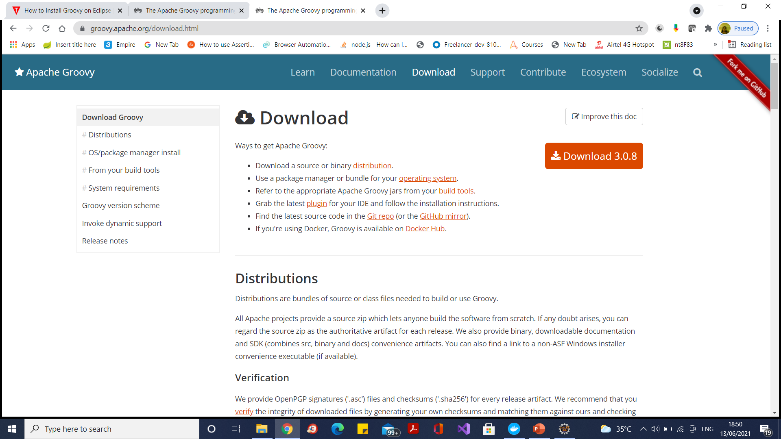
Groovy installation

Slide 5
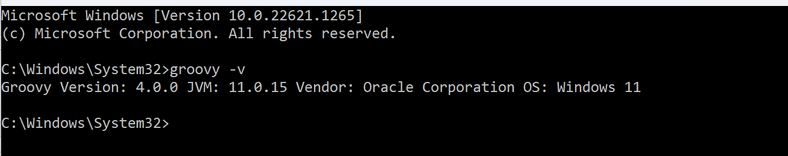
Groovy installation

Slide 6
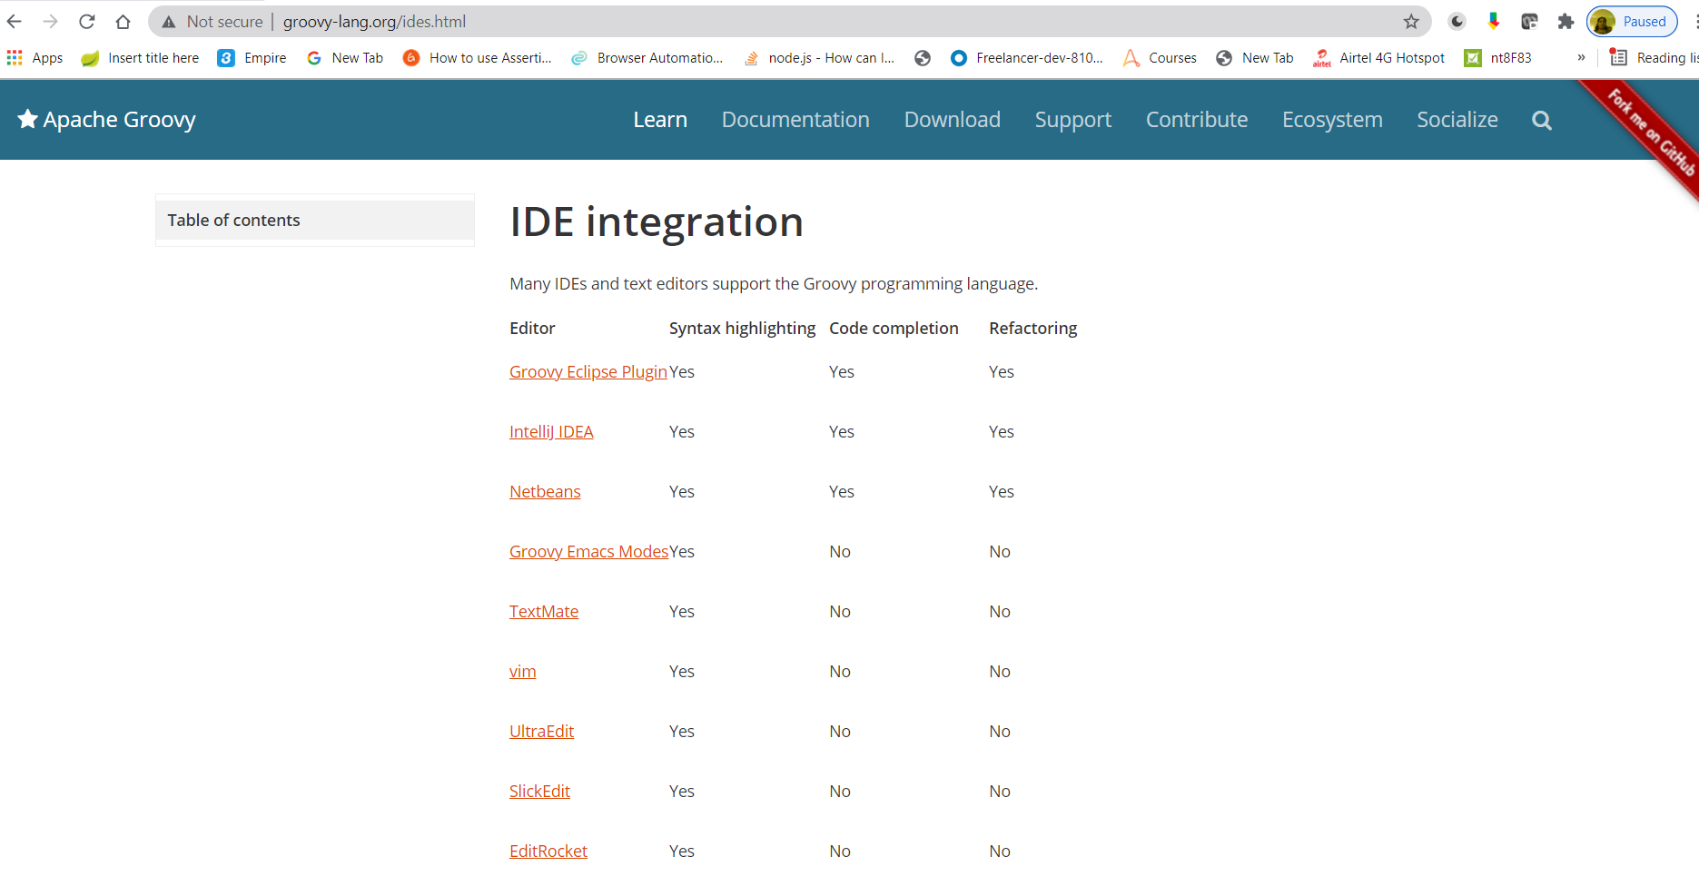
Groovy installation

Slide 7
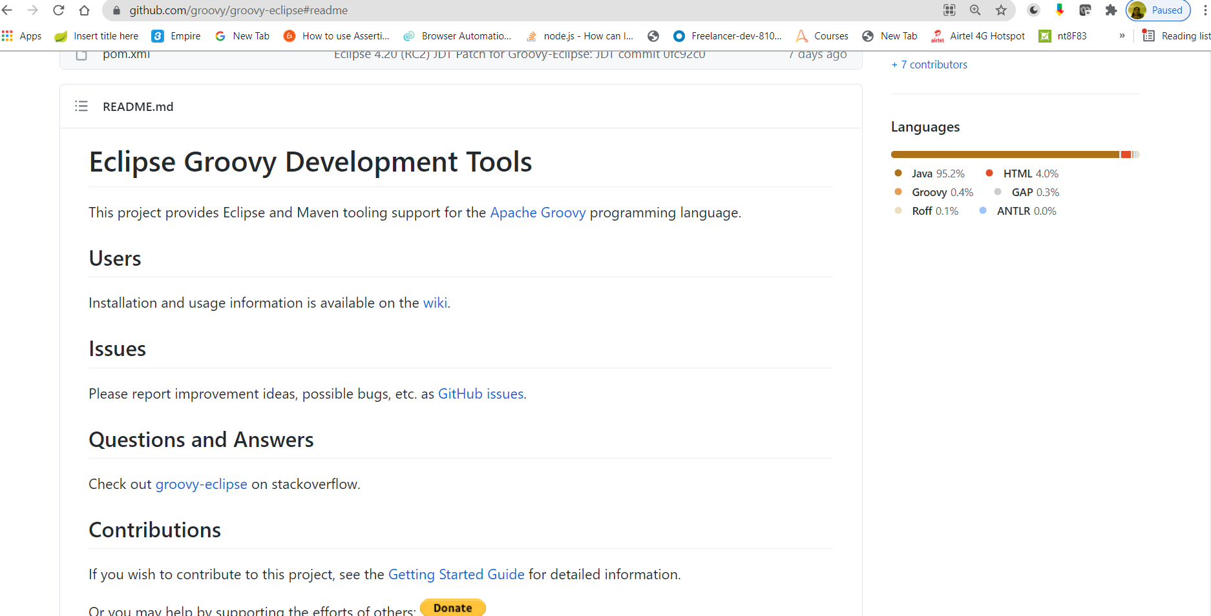
Groovy installation
Go to Documentation

Slide 8
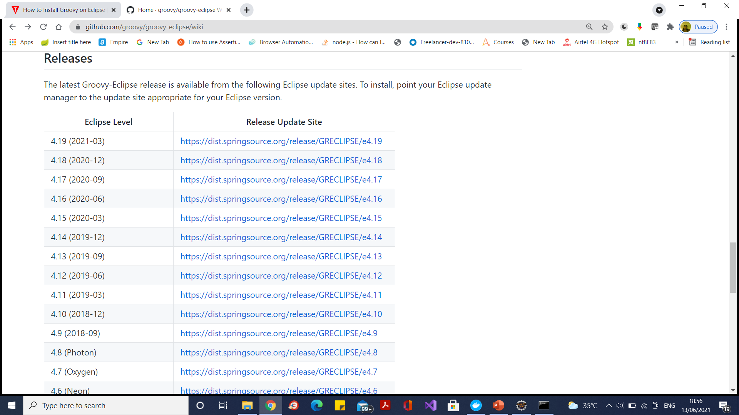
Groovy installation
Go to Releases

Slide 9
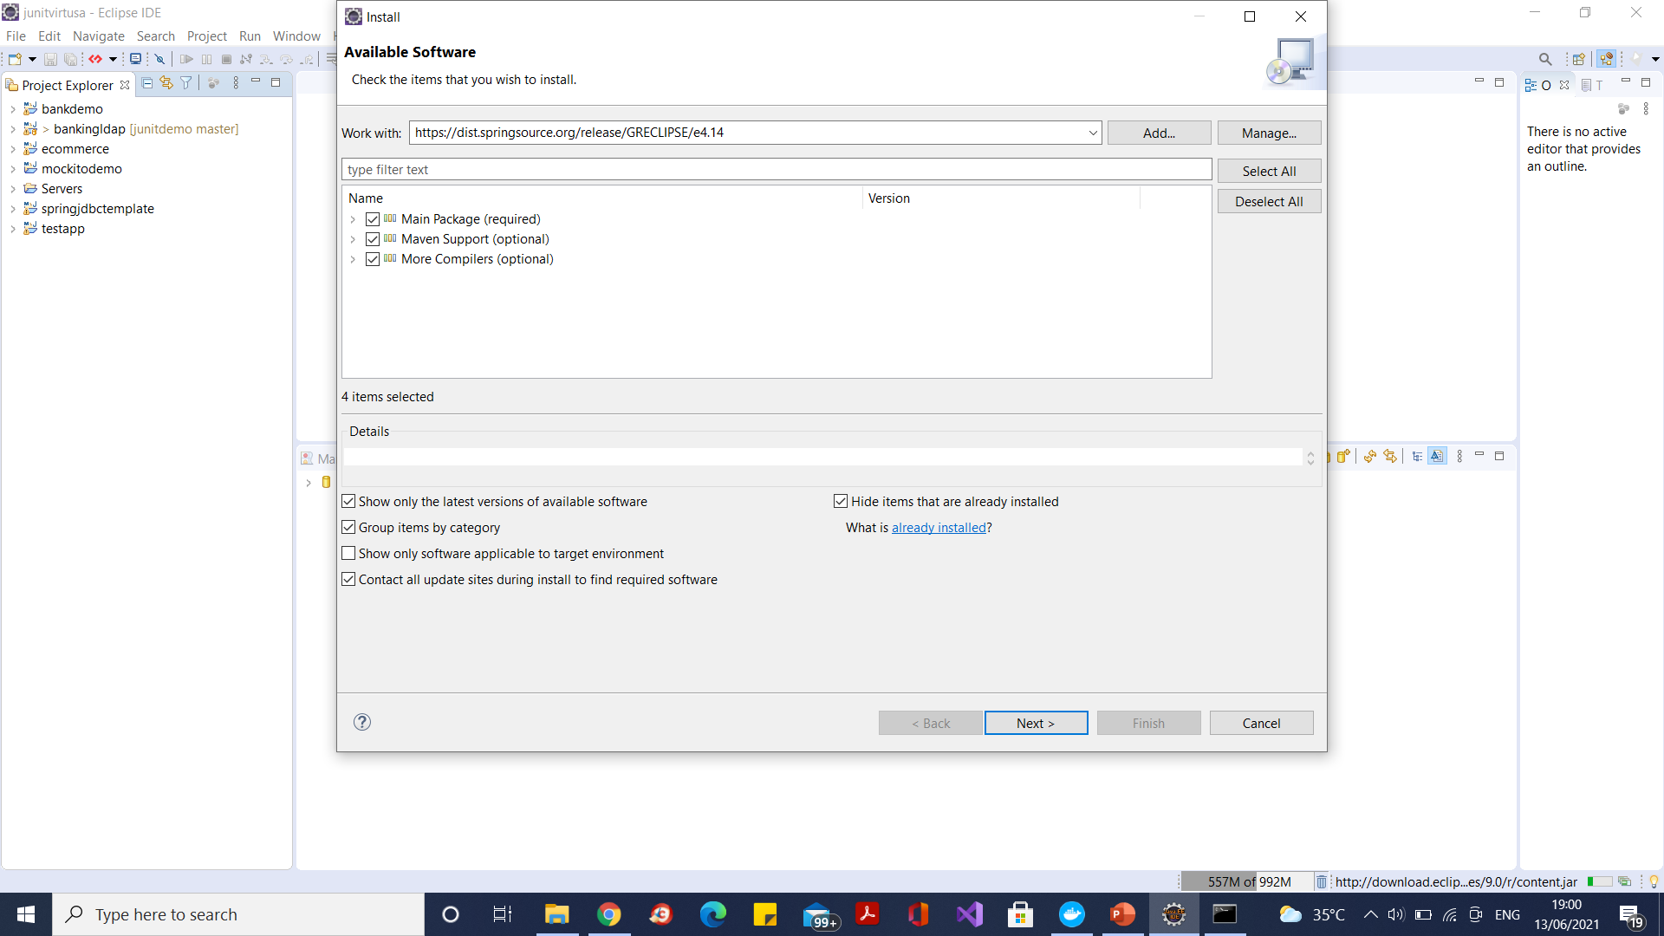
Groovy installation
Select only groovy 4.0 compiler

Slide 10
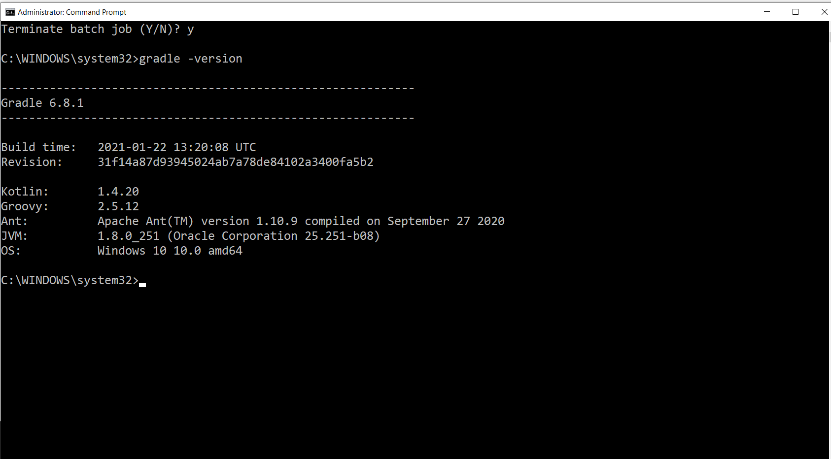
Groovy installation

Slide 11
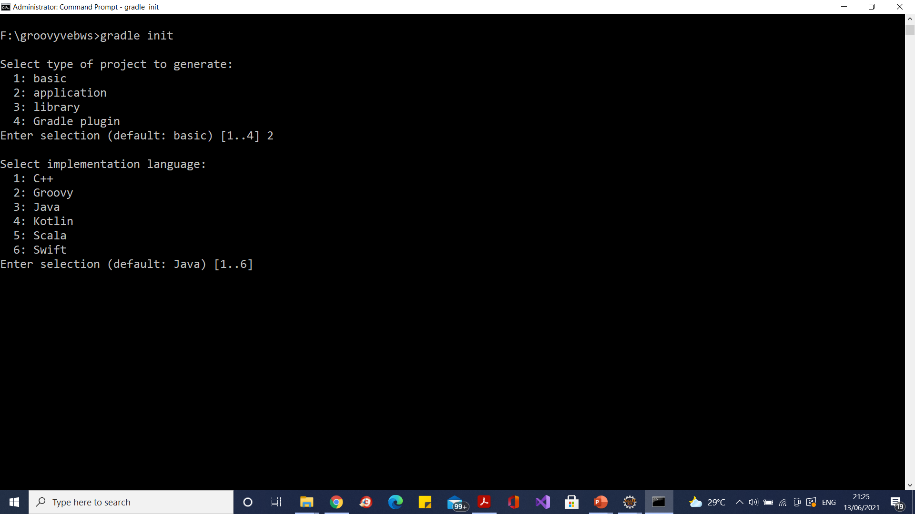
Groovy installation

Slide 12
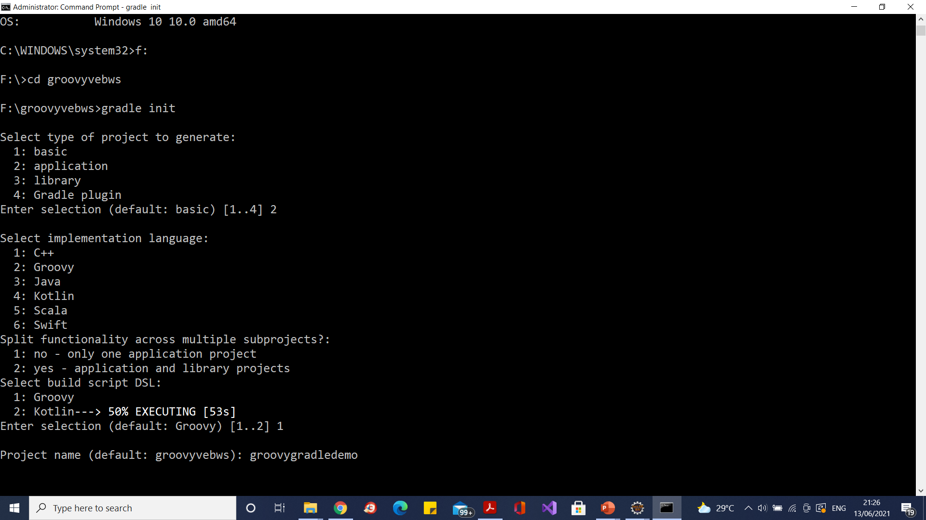
Groovy installation

Slide 13
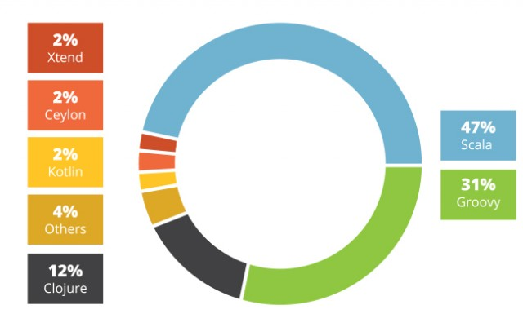
Next JVM

Slide 14
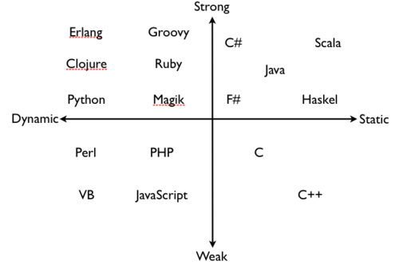
Static Vs Dynamic Languages

Slide 15
Static Vs Dynamic Languages
Static Languages enforce type constraints at compile Time
Many bugs caught early in development yields performance gains
Can introduce friction in development
ill suited for flexible data formats

Slide 16
Static Vs Dynamic Languages
Dynamic Languages enforce type constraints at run time
Can lead to more rapid development
Well suited for flexible data formats
Some bugs may not be found until later in development
Performance tends to be slower

Slide 17
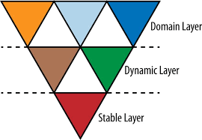
Polygot Programming
Gradle,Camel
Groovy,Ruby,Clojure
Java,Scala

Slide 18
Groovy
Groovy was developed by Jochen Theodorou, Guillaume Laforge, Cedric Champeau, and Paul King.
Its typing discipline is strong, static and dynamic.
It was licensed under the Apache 2.0 license.
It first appeared in the year 2003.
Its file extension is .groovy and was designed by James Strachan.
An agile dynamic language for the Java Platform with many features that are inspired by languages like Python, Ruby and Smalltalk, making them available to Java developers using a Java-like syntax.

Slide 19
Why groovy
Groovy is an agile and dynamic language
Seamlessly integration with all existing Java objects and libraries
Feels easy and natural to Java developers
More concise and meaningful code compares to Java
You can use it as much or as little as you like with Java apps

Slide 20
Why groovy

Slide 21
Where does Groovy FIT
Web Application Development
Building Domain Specific Language
Writing acceptable test cases
Scripting in JVM Environment

Slide 22
Scripting Languages The old new new thing…
Productivity / Rapid Development / Agile
Interpreted (No Compile Cycle)
Expressive - Shorter, Less Verbose Syntax
Feature Rich yet Simple and Productive
Shell / System Integration / Systems “Glue”
Dynamic
Open Source – also code available by default
Advanced languages features Closures / Mix Ins

Slide 23
Script Languages Reputation
Weakly Typed
Procedural
Scalability / Enterprise Ready
Not Maintainable – (Perl)
Lack of threading support
Lack of IDE / Debugger support
Cross Platform Support
Performance
Specialized / Not general purpose

Slide 24
Groovy Overview
Syntactically very close to Java
Leverages investment in Java
Interpreted-ish. .groovy files fully parsed and classes are generated on the fly, via a custom class loader.
Can be compiled and fully integrated with traditional Java application.
Language level support for lists, maps, regular expressions.
Supports closures, dynamic typing, meta object protocol.

Slide 25
Groovy & Java – Seamless Integration
Groovy code co-exists with Java Code and runs in the JRE.
Syntax nicely aligned with Java.

Slide 26
Power in your code: a feature-rich language
Groovy has three main enhancements over and above those of Java: language features, libraries specific to Groovy, and additions to the existing Java standard classes (known as the Groovy Development Kit, or GDK)

Slide 27
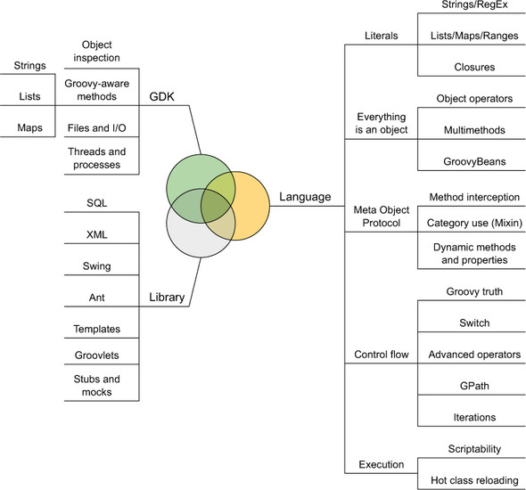
Power in your code: a feature-rich language

Slide 28
Direct vs. Precompiled Mode in Groovy
Direct mode. Code is "directly executed, without producing any executable files".
Precompiled mode. The second way, which involves taking the code and "compiling it to Java bytecode and running it as regular Java application code within a Java Virtual Machine (JVM)".

Slide 29
Direct vs. Precompiled Mode in Groovy

Slide 30
Compiling and executing Groovy programs
groovyc - the Groovy compiler
groovyc is the Groovy compiler command line tool.
It allows you to compile Groovy sources into bytecode.
It plays the same role as javac in the Java world.
The easiest way to compile a Groovy script or class is to run the following command:
groovyc MyClass.groovy

Slide 31
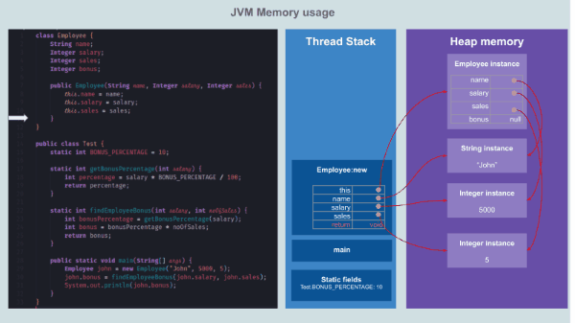
Visualizing memory management in JVM(Java, Kotlin, Scala, Groovy, Clojure)

Slide 32
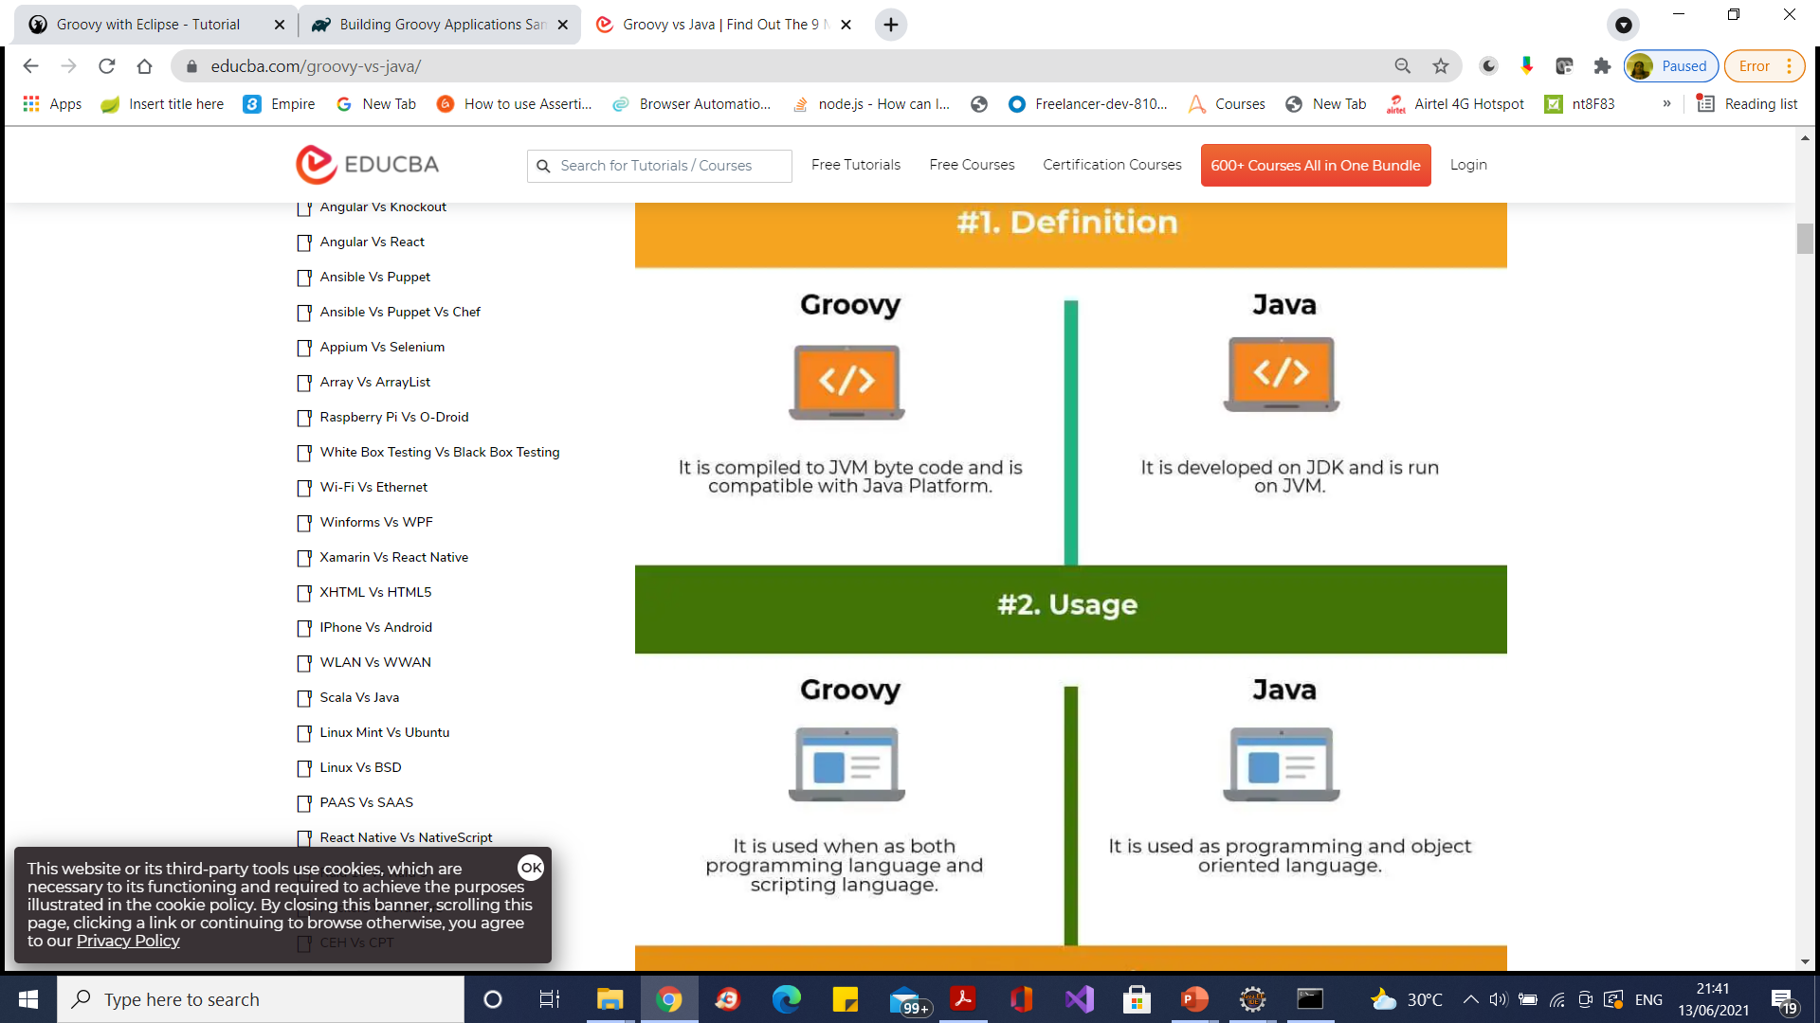
Groovy vs Java

Slide 33
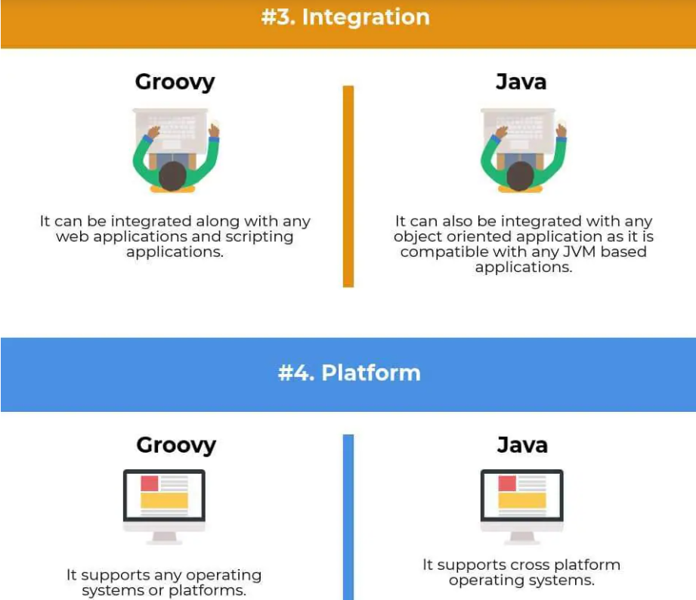
Groovy vs Java

Slide 34
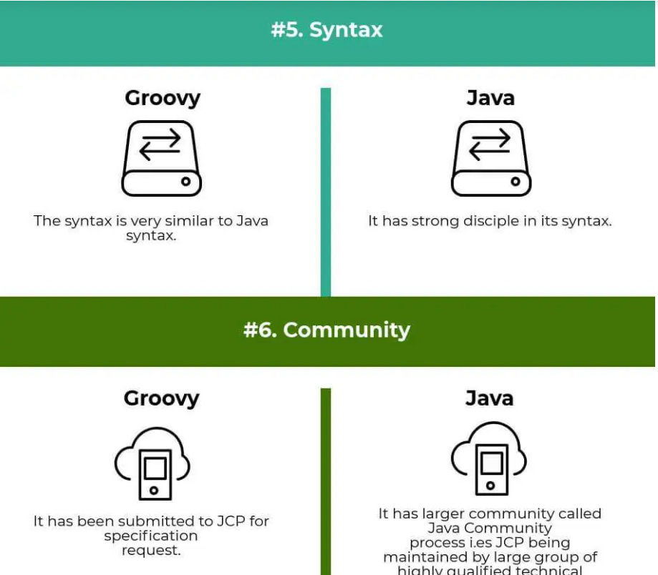
Groovy vs Java

Slide 35
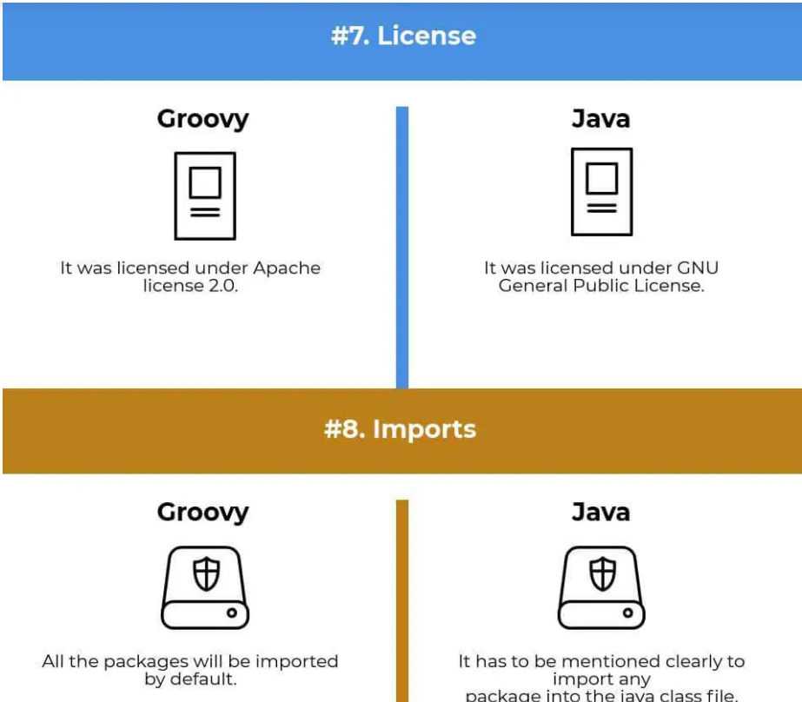
Groovy vs Java

Slide 36
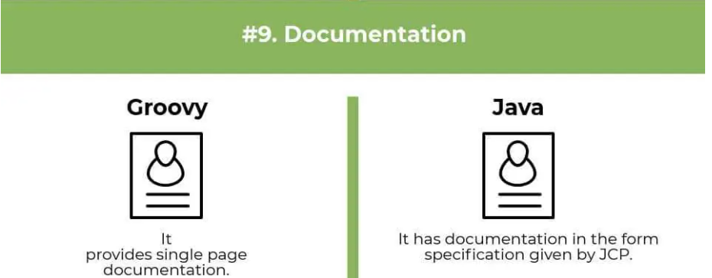
Groovy vs Java

Slide 37
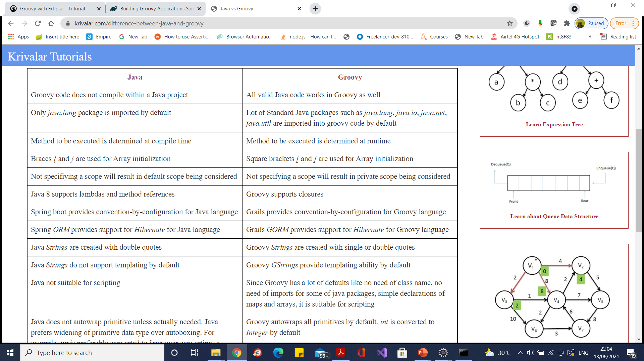
Groovy vs Java

Slide 38
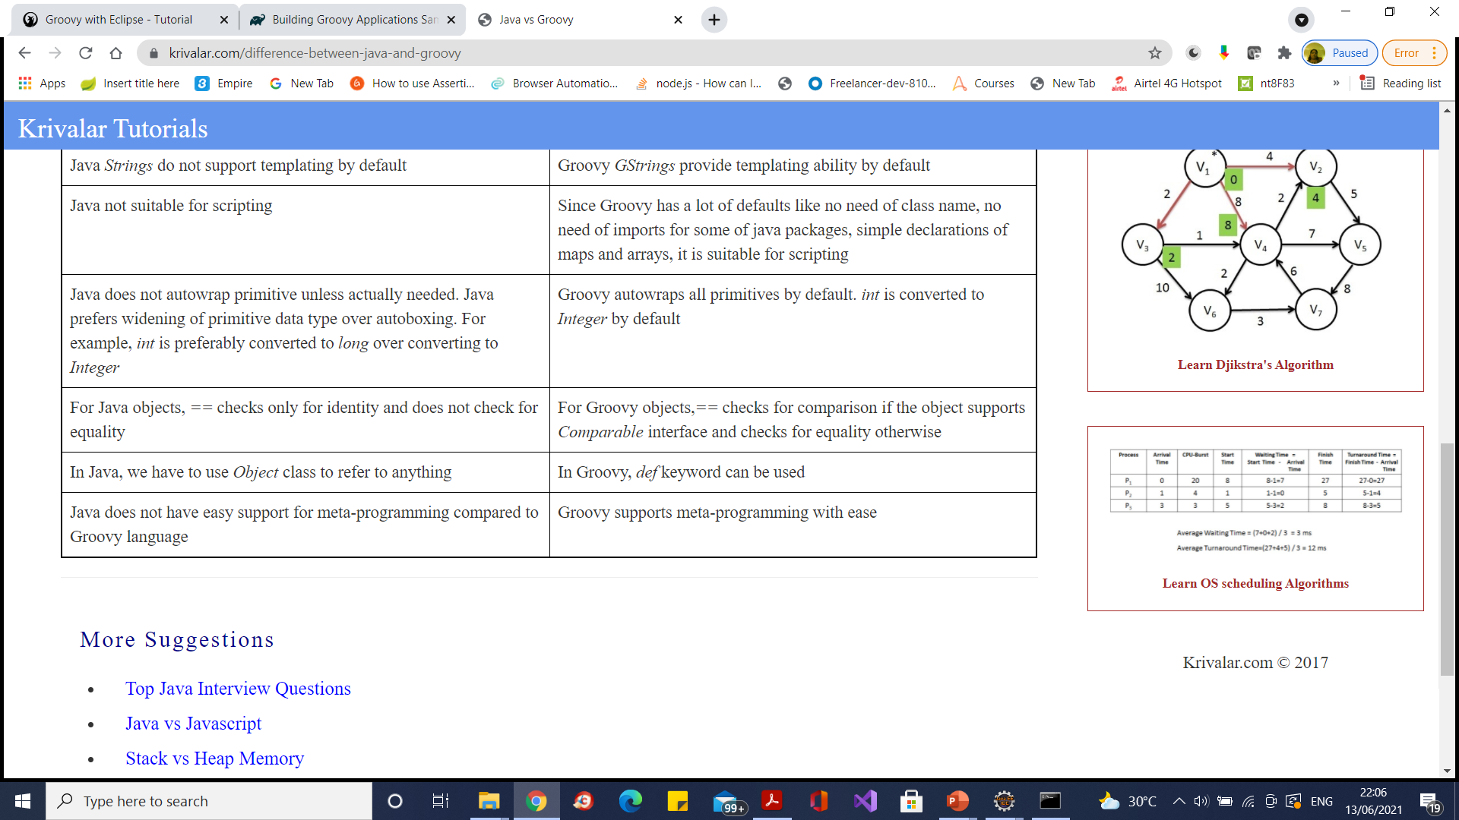
Groovy vs Java

Slide 39
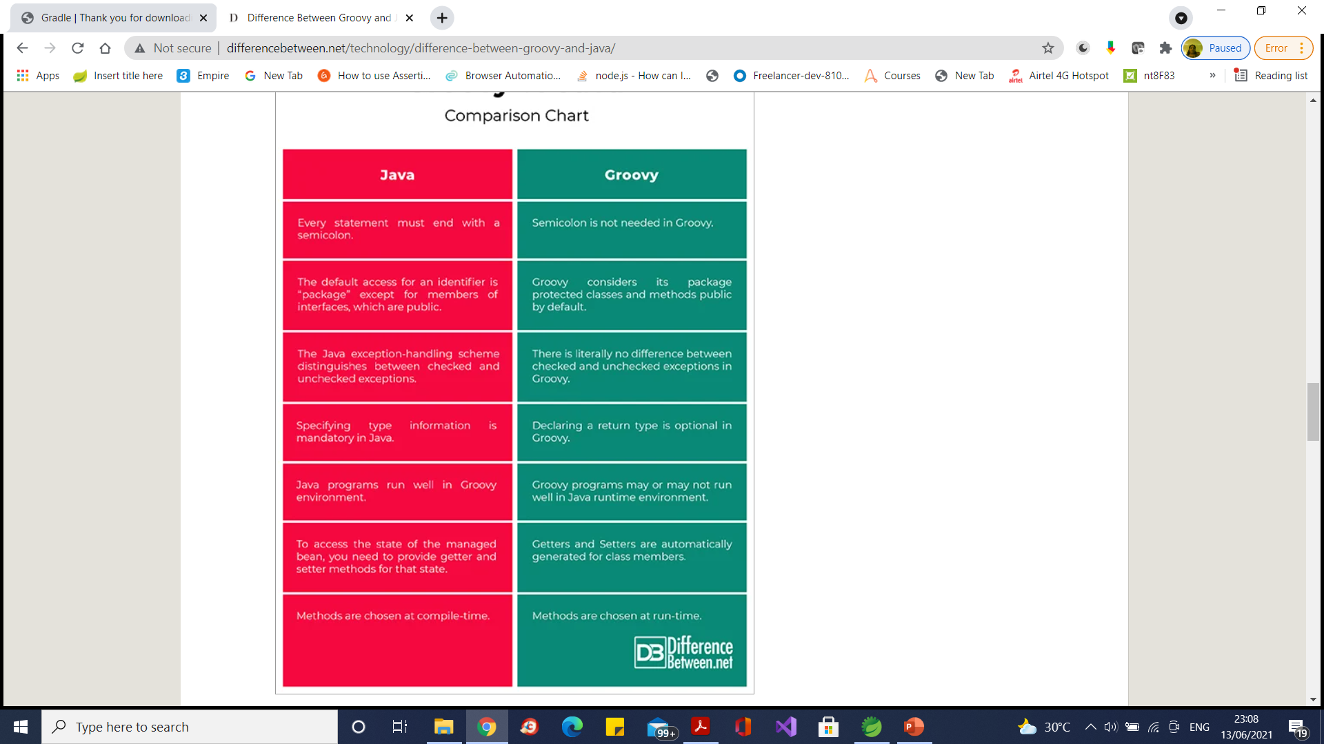
Groovy vs Java

Slide 40
Default Imports
java.io.*
java.lang.*
java.math.BigDecimal
java.math.BigInteger
java.net.*
java.util.*
groovy.lang.*
groovy.util.*

Slide 41
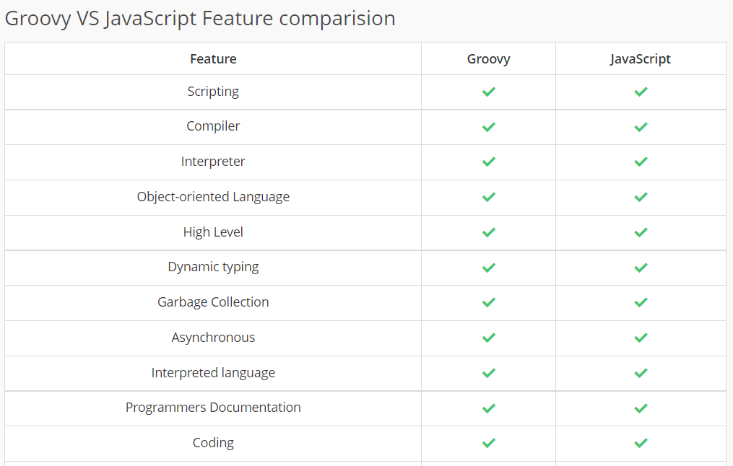
Groovy vs JavaScript

Slide 42
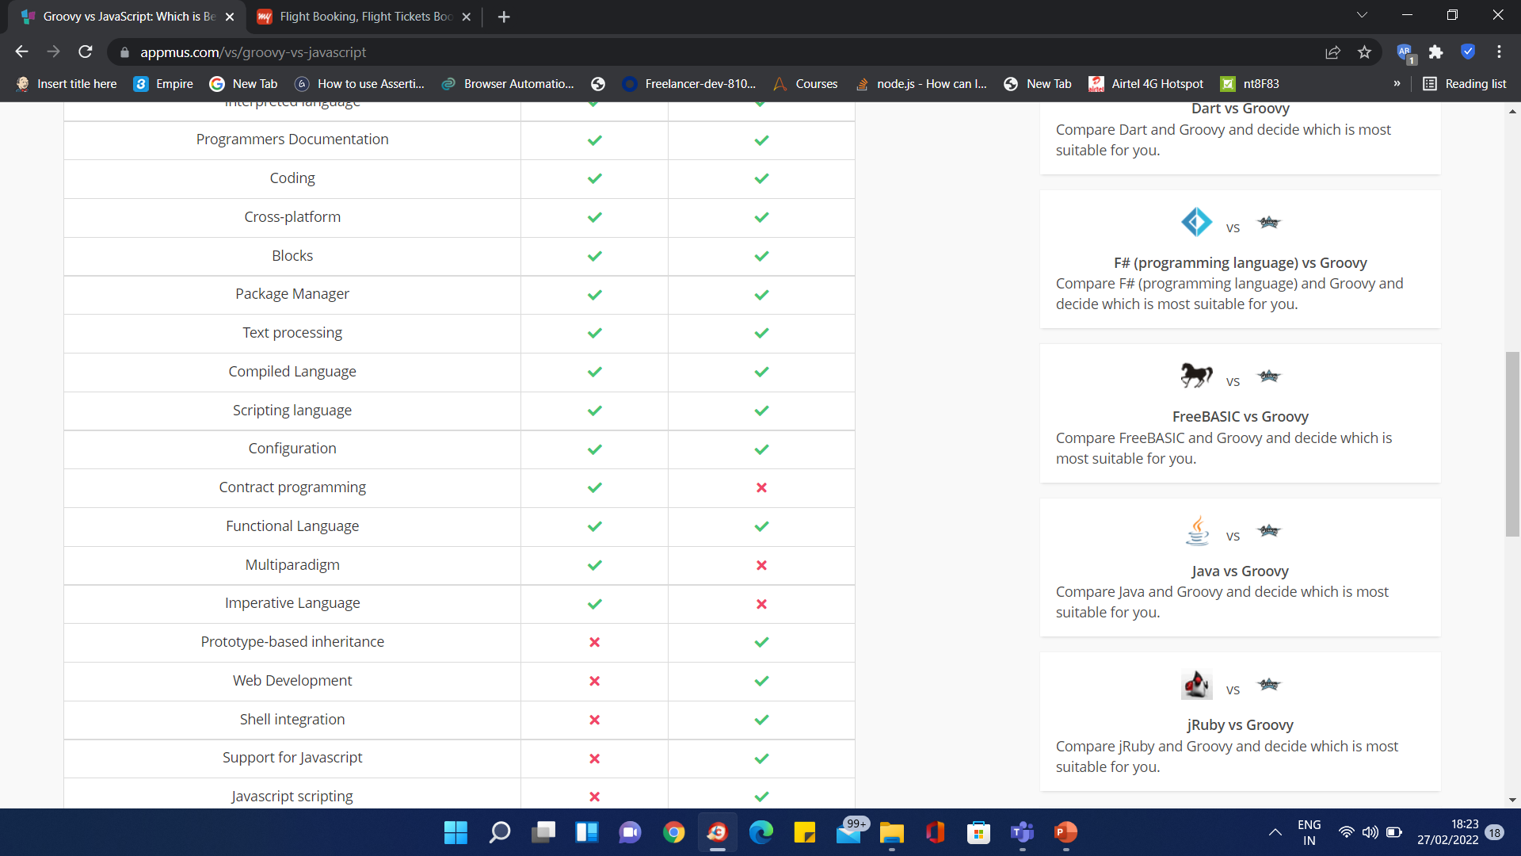
Groovy vs JavaScript

Slide 43
Groovy Comments
#!/usr/bin/groovy
// some line comment
/*
some multiline
comment
*/

Slide 44
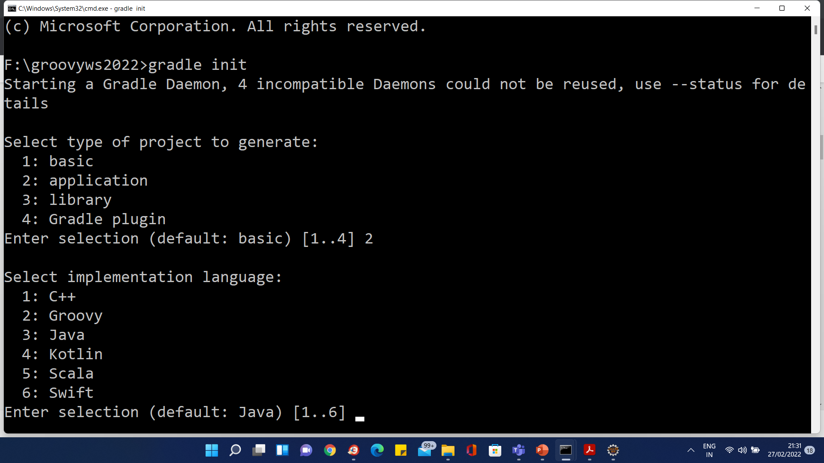
Gradle Project

Slide 45
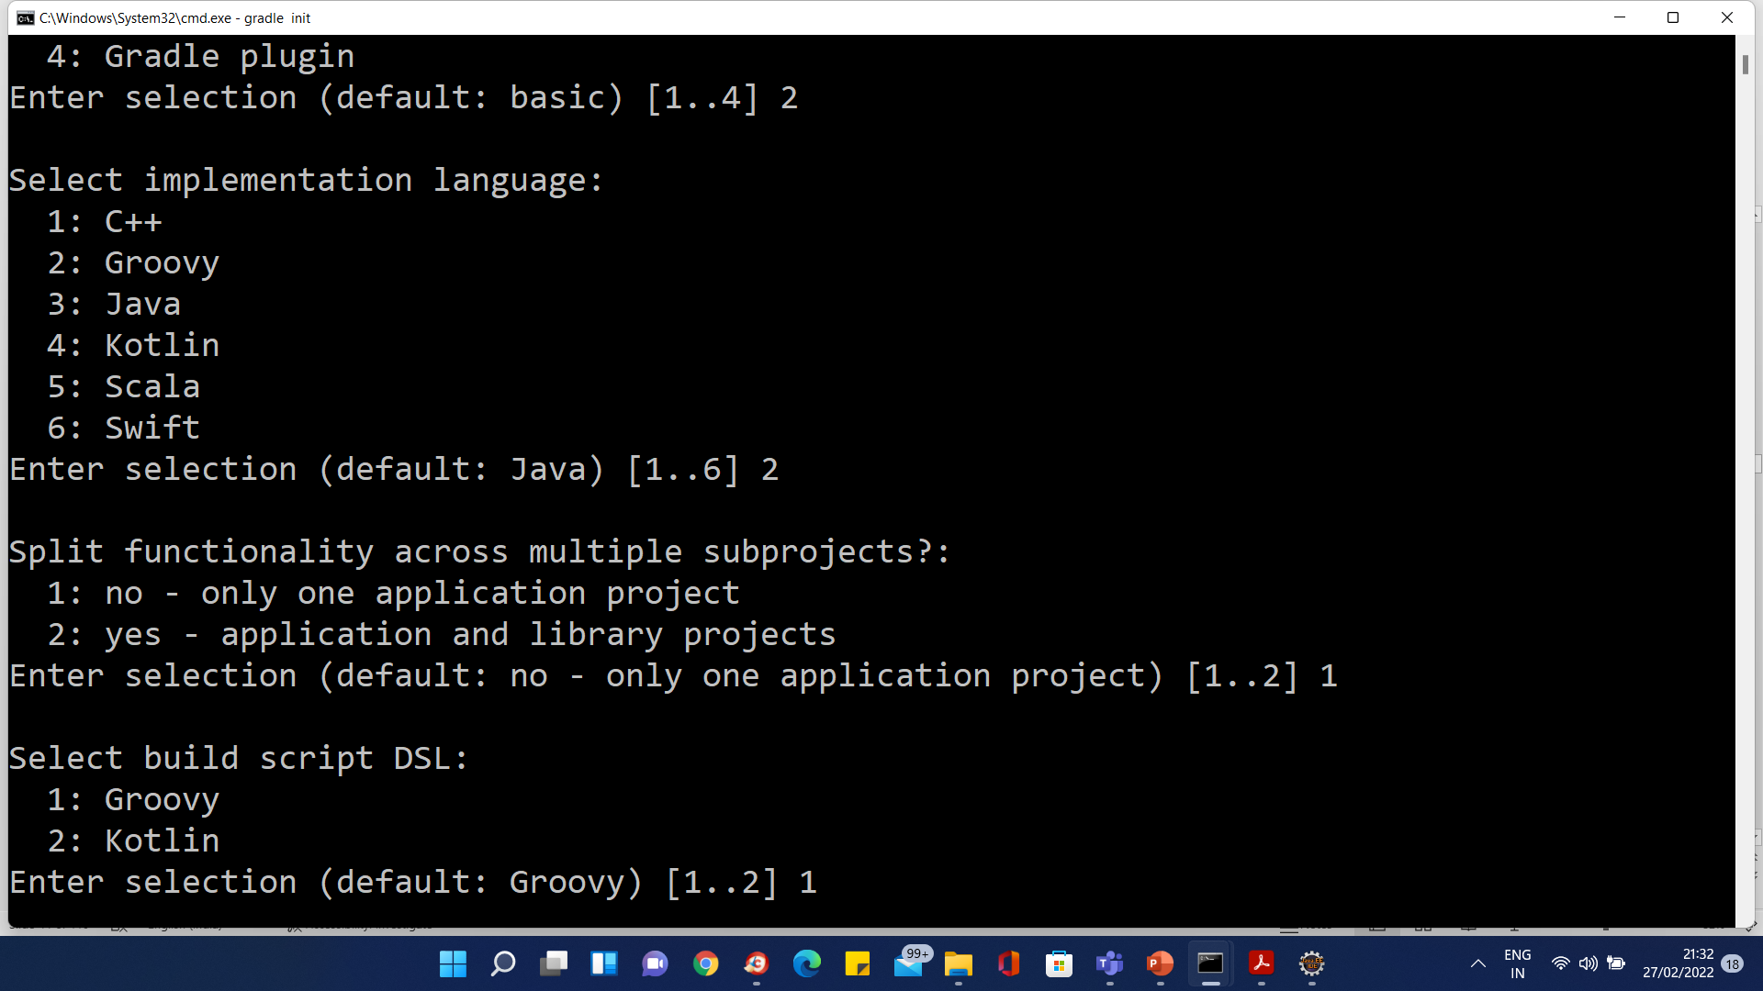
Gradle Project

Slide 46
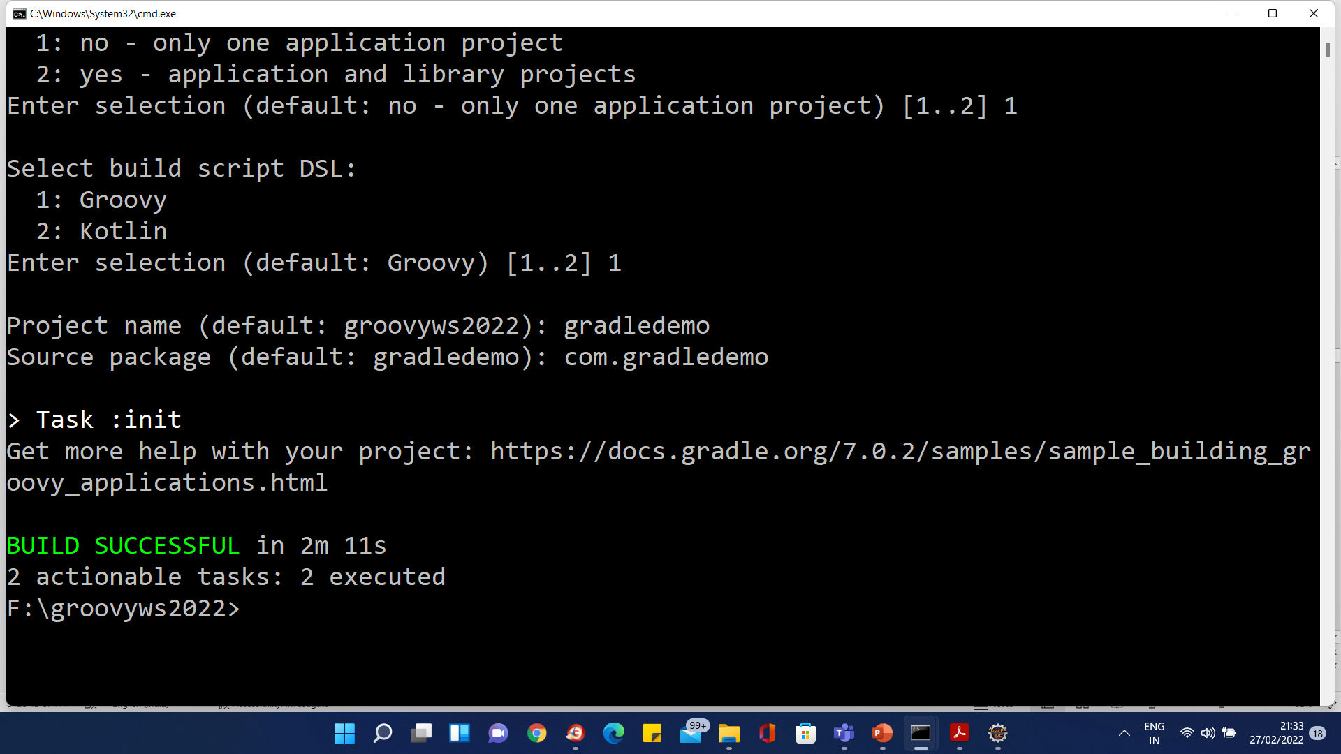
Gradle Project

Slide 47
Groovy Script
To run type ‘groovy hello.groovy’
Parenthesis are optional
Ending semi-colons optional
Class declaration optional
Main entry point optional
Single Quotes or Double quotes for Strings. Groovy has several string styles.
System.out is assumed - Groovy automatically imports the packages groovy.lang.*, groovy.util.*, java.lang.*, java.util.*, java.net.*, and java.io.*

Slide 48
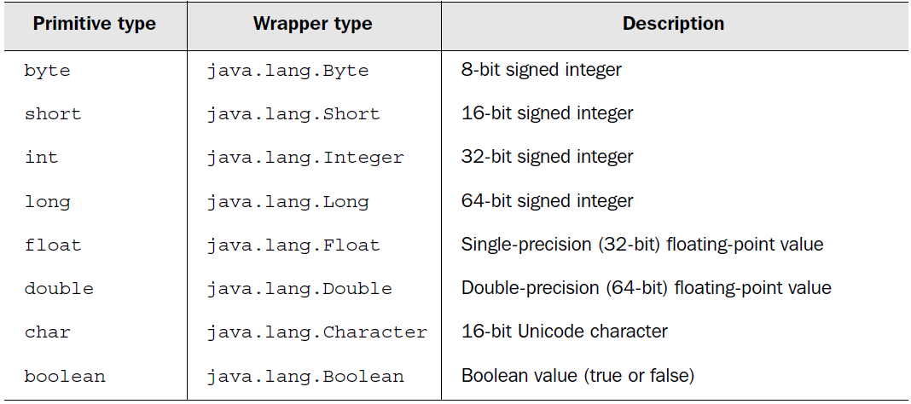
Groovy Types

Slide 49
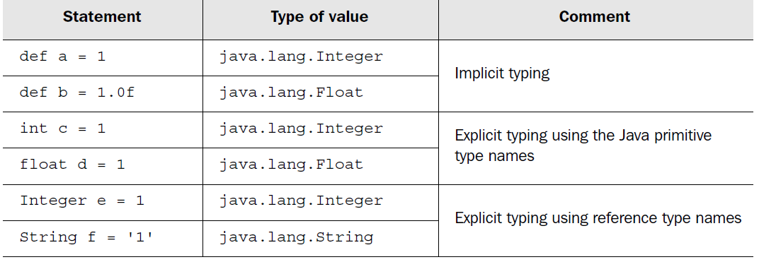
Groovy Types

Slide 50
Groovy Types
Everything is an object no primitive types.
Primitive types are auto boxed
Optional Typing – If not explicitly specified assumed to be java.lang.Object
Type safe – Unlike some scripting languages, Groovy doesn’t allow one type to be treated as another without a well defined conversion being available.

Slide 51
Def keyword
The def keyword is used to define an untyped variable or a function in Groovy, as it is an optionally-typed language.
When we're unsure of the type of a variable or field, we can leverage def to let Groovy decide types at runtime based on the assigned values:
Def readln=<Swing Dialog Box>
def firstName = readln “Enter name”
def listOfCountries = ['USA', 'UK', 'FRANCE', 'INDIA']
Here, firstName will be a String, and listOfCountries will be an ArrayList.
We can also use the def keyword to define the return type of a method:
def multiply(x, y) {
return x*y
}

Slide 52
Types Example
a = 1 // Implicit typing to Integer
b = 'howdy' // Implicit typing to String
int c = 33 // Explicit typing to Integer
def d = 5.2f // def keyword means any type
println 'a is ' + a.class.name
println 'b is ' + b.class.name
println 'c is ' + c.class.name
println 'd is ' + d.class.name // class name as property
Output
a is java.lang.Integer
b is java.lang.String
c is java.lang.Integer
d is java.lang.Float

Slide 53
Operator Overloading
Operator | Method
a + b | a.plus(b)
a – b | a.minus(b)
a * b | a.multiply(b)
a / b | a.div(b)
a % b | a.mod(b)
a++ or ++a | a.next()
a-- or --a | a.previous()
a**b | a.power(b)
a | b | a.or(b)
a&b | a.and(b)
a^b | a.xor(b)
~a | a.negate()
a[b] | a.getAt(b)
a[b] = c | a.putAt(b, c)
Operator | Method
a << b | a.leftShift(b)
a >> b | a.rightShift(b)
a >>> b | a.rightShiftUnsigned(b)
switch(a){ case b: } | b.isCase(a)
a == b | a.equals(b)
a != b | ! a.equals(b)
a <=> b | a.compareTo(b)
a > b | a.compareTo(b) > 0
a >= b | a.compareTo(b) >= 0
a < b | a.compareTo(b) < 0
a <= b | a.compareTo(b) <= 0

Slide 54
Strings
Single Quotes – java.lang.String
Double Quotes – groovy.lang.GString – Allow replacement of ${vars}
Triple Single Quotes – Multi Line Strings, Newlines always \n, Whitespace preserved.
Triple Double Quotes – Multi Line GStrings
Forward Slash – Escape backslashes ignored, makes Regular Expressions more readable

Slide 55
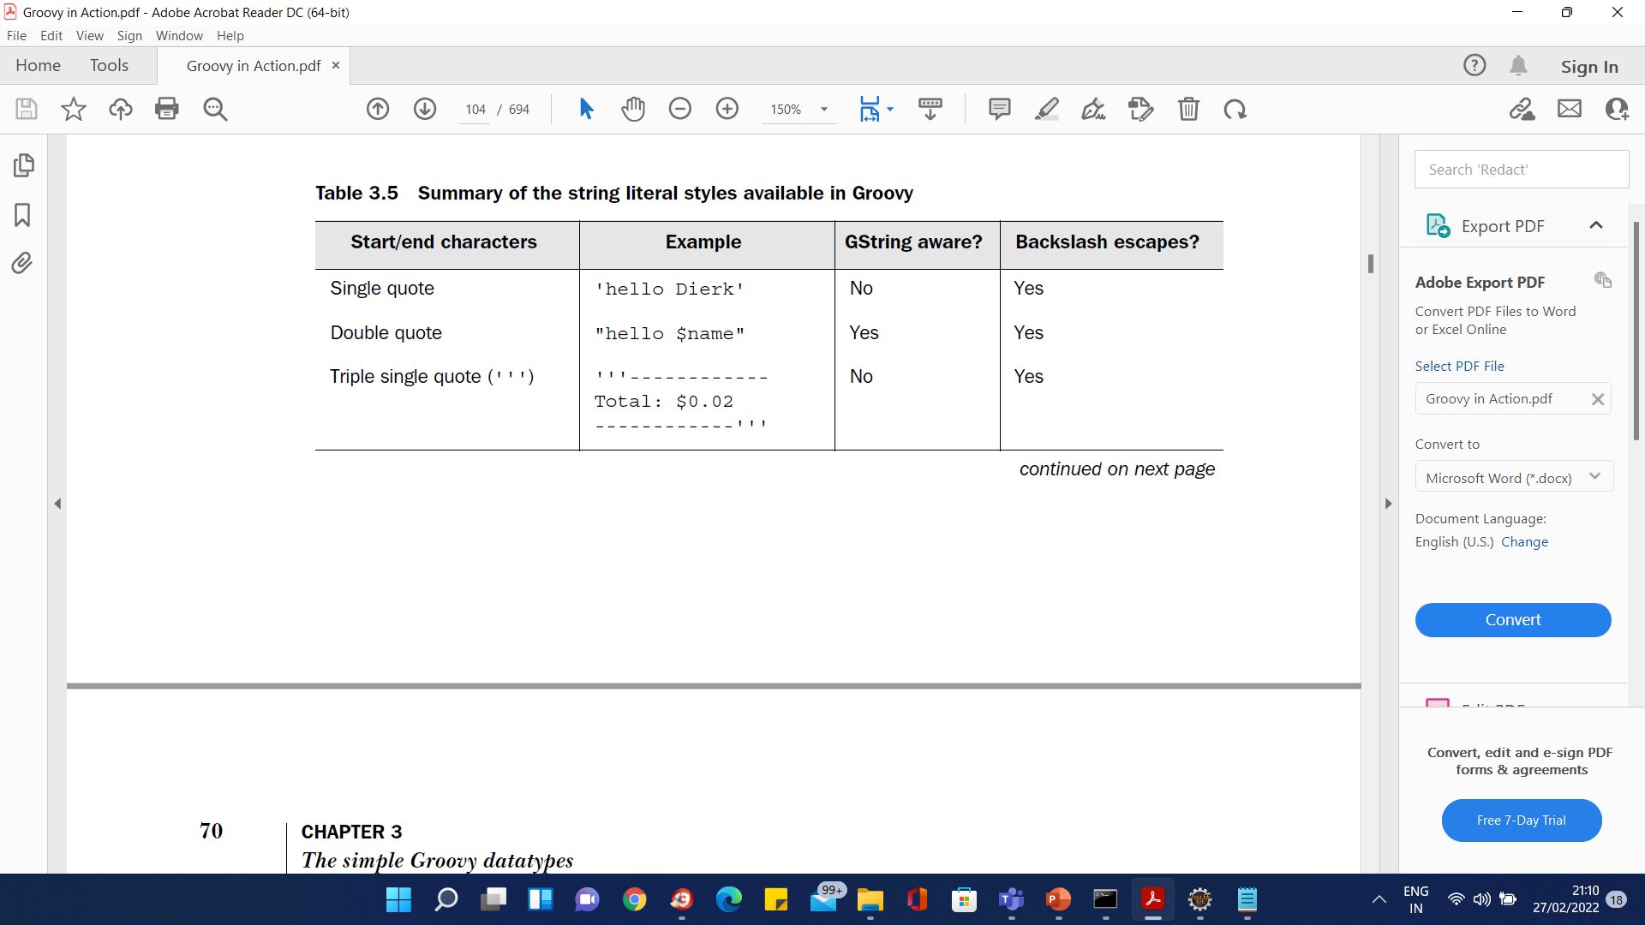
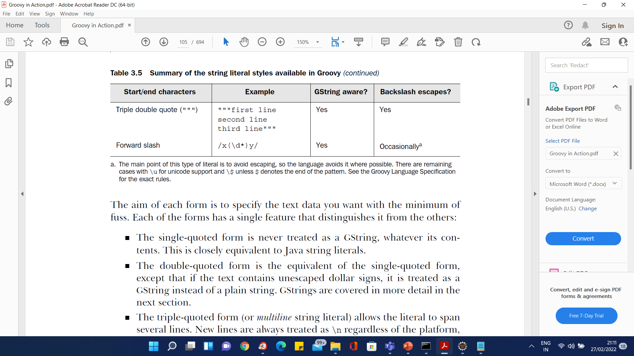
Strings

Slide 56
Strings
me = 'Tarzan'
you = 'Jane'
line = "me ${me} - you $you"
assert line == 'me Tarzan - you Jane'
// Note abbrev dollar syntax $you
// Note == is equality not identity
date = new Date(0)
out = "Year $date.year Month $date.month Day $date.date"
assert out == 'Year 70 Month 0 Day 1'
out = "Date is ${date.toGMTString()} !"
assert out == 'Date is 1 Jan 1970 00:00:00 GMT !'
// Note $date.month access month property

Slide 57
Strings
// Multi line
sql = """
SELECT FROM MyTable
WHERE Year = $date.year
"""
// Literal dollar sign
out = "my 0.02\$"
// Slashy Strings, don't need to escape
assert "abc" == /abc/
assert "\\d" == /\d/

Slide 58
Regular Expressions
Find Operator: =~
Creates a matcher.
Match Operator: ==~
Matches a regular expression.
Pattern Operator: ~String
Creates a pattern from a string.

Slide 59
Regular Expressions
// Find operator
assert "aaa1bbb2ccc3" =~ /bbb/
// Match operator – must match entire string
assert "aaa1bbb2ccc3" ==~ /(...\d)*/
// Patterns
def p = ~/a*b/
assert p instanceof Pattern
def m = p.matcher("aaaaab");
assert m.matches()

Slide 60
Ranges
Specify an upper and lower bound of some sequence.
Can be used to replace:
if (a >= 0 && a <= upperBound) {
// do something with a
}
Ranges are Objects
lowerbound..upperbound: inclusive
Lowerbound..<upperbound: half inclusive
Supports Numbers, Strings, Dates, Reverse Ranges.
Can create your own, by overriding next(), previous() and implements Comparable

Slide 61
Ranges Example
assert (0..10).contains(0)
assert (0..10).contains(5)
assert (0..10).contains(10)
assert (0..10).contains(-1) == false
assert (0..10).contains(11) == false
assert (0..<10).contains(9)
assert (0..<10).contains(10) == false
assert ('a'..'c').contains('b')
log = ''
// Replacement for Java for statements.
for (element in 5..9){
log += element
}
assert log == '56789'

Slide 62
Lists and Maps
Groovy has language level support for maps
Lists specified with [item, item, item] syntax
java.util.ArrayList under the hood
Maps specified with [name1:value, name2:value, name3:value] syntax
java.util.HashMap under the hood.
Use [ ] operator to access.
Define closures to ease iteration.

Slide 63
Lists - Specifying
myList = [1,2,3]
assert myList.size() == 3
assert myList[0] == 1
assert myList instanceof ArrayList
emptyList = []
assert emptyList.size() == 0
longList = (0..1000).toList()
assert longList[555] == 555
explicitList = new ArrayList()
explicitList.addAll(myList)
assert explicitList.size() == 3
explicitList[0] = 10
assert explicitList[0] == 10

Slide 64
Lists – Overloaded Subscript Operator
myList = ['a','b','c','d','e','f']
assert myList[0..2] == ['a','b','c'] // getAt(Range)
assert myList[0,2,4] == ['a','c','e'] // getAt(Index Collection)
// putAt(Range)
myList[0..2] = ['x','y','z']
assert myList == ['x','y','z','d','e','f']
myList[3..5] = []
assert myList == ['x','y','z']
myList[1..1] = ['y','1','2']
assert myList == ['x','y','1','2','z']

Slide 65
Lists – Negative Indexes
Count from the back of the list. The last index is -1.
Can be used with ranges.
list[-3..-1] gives you the last three entries.
list[1..-2] to cut away the first and the last entry.

Slide 66
Lists – Adding and Removing
myList = []
myList += 'a' // plus(Object)
assert myList == ['a']
myList += ['b','c'] // plus(Collection)
assert myList == ['a','b','c']
myList = []
myList << 'a' << 'b' // leftShift is like 'append'
assert myList == ['a','b']
assert myList - ['b'] == ['a'] // Minus to remove

Slide 67
Lists – GDK Methods
Groovy Development Kit adds many methods to the collection classes.
Many take closures to perform some operation on the collection
Examples: min, max, sort, sum, collect, each, find, unique etc…

Slide 68
Lists Iteration with Closures
def list = [1,2,3]
// Find even numbers
def even = list.find {item -> item % 2 == 0}
assert even == 2
// Is every number less than 5?
assert list.every { item -> item < 5}
// Is any number less than 2
assert list.any { item -> item < 2}
// Append each item to store
def store = ''
list.each { item -> store += item }
assert store == '123'

Slide 69
Maps - Specifying
def myMap = [a:1, b:2, c:3]
assert myMap instanceof HashMap
assert myMap.size() == 3
assert myMap['a'] == 1
def emptyMap = [:]
assert emptyMap.size() == 0
def explicitMap = new TreeMap()
explicitMap.putAll(myMap)
assert explicitMap['a'] == 1

Slide 70
Maps - Access
def myMap = [a:1, b:2, c:3]
// retrieve
assert myMap['a'] == 1
assert myMap.a == 1
assert myMap.get('a') == 1
assert myMap.d == null
assert myMap.get('d',0) == 0
assert myMap.d == 1 // now it's there
// assign
myMap['d'] = 1
assert myMap.d == 1
myMap.d = 2
assert myMap.d == 2

Slide 71
Maps - Iteration
def myMap = [a:1, b:2, c:3]
// Dump contents by each entry
myMap.each {entry ->
println "$entry.key = $entry.value"
}
// Dump contents by each key/value
myMap.each {key, value ->
println "$key = $value"
}
// Dump contents by for
for (key in myMap.keySet())
println "$key = " + myMap[key]

Slide 72
Closures
A closure in Groovy is an open, anonymous, block of code that can take arguments, return a value and be assigned to a variable.
Closure may reference variables declared in its surrounding scope.
In opposition to the formal definition of a closure, Closure in the Groovy language can also contain free variables which are defined outside of its surrounding scope.
https://groovy-lang.org/closures.html

Slide 73
Closures
A closure definition follows this syntax:
{ [closureParameters -> ] statements }
Where [closureParameters->] is an optional comma-delimited list of parameters, and statements are 0 or more Groovy statements.
The parameters look similar to a method parameter list, and these parameters may be typed or untyped.

Slide 74
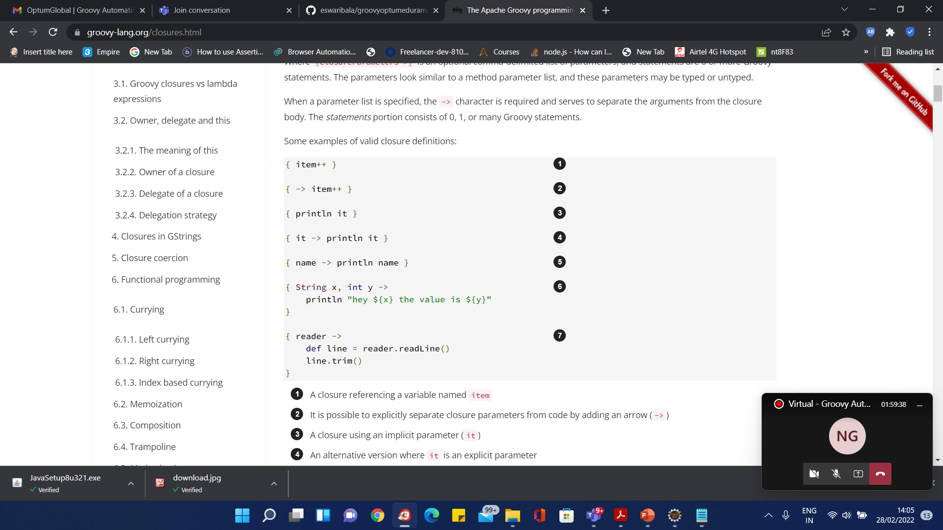
Closures

Slide 75
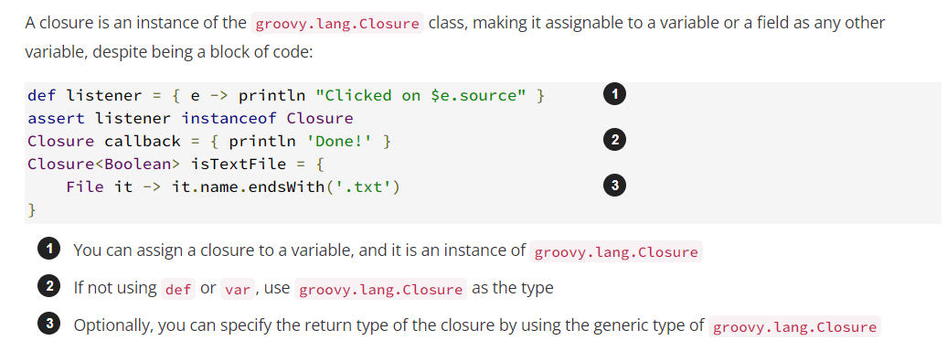
Closures

Slide 76
Closures
A powerful and integral feature of Groovy. You won’t be able to avoid them.
Essentially a block of code wrapped in an object.
Similar to anonymous inner classes in Java but less verbose and more flexible.
Aka C# Delegate, Lisp Lambda, C function pointers.
Useful for iteration, using resources safely.
Avoids interface proliferation (Runnables, Observers, Listeners, Visitors, Comparators, Strategies, Commands, Controllers)
Have access to local variables without having to make them final as Java anonymous inner classes require.
Proposal from Gosling and others to add Closures to Java 7.

Slide 77
Closures - Specifying
def list = [1,2,3]
// Closure to print contents of a list
def closure = { x -> println x }
list.each(closure)
// Simplify 1 - Create closure within each
list.each({ x -> println x })
// Simplify 2 - () not required if closure last param
list.each { x -> println x }
// Simplify 3 - 'it' is default parameter name if one param
list.each { println it }

Slide 78
Closures - Calling
// Create a closure
def adder = { x, y -> return x + y }
// Call it using the call method
assert adder.call(2, 6) == 8
// Abbreviated call
assert adder(4, 3) == 7
// In a method
void adjustSalary(Closure adjustment) {
for(e in employees) {
adjustment(e)
}
}

Slide 79
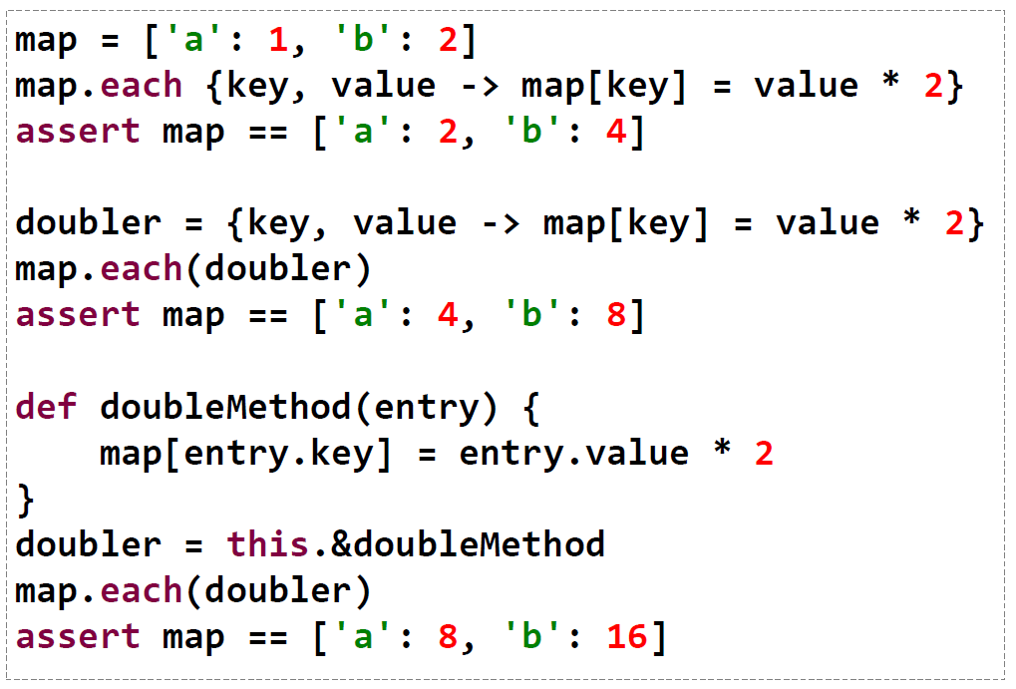
Closures

Slide 80
Normal Parameters
def closureWithOneArg = { str -> str.toUpperCase() }
assert closureWithOneArg('groovy') == 'GROOVY'
def closureWithOneArgAndExplicitType = { String str -> str.toUpperCase() }
assert closureWithOneArgAndExplicitType('groovy') == 'GROOVY'
def closureWithTwoArgs = { a,b -> a+b }
assert closureWithTwoArgs(1,2) == 3
def closureWithTwoArgsAndExplicitTypes = { int a, int b -> a+b }
assert closureWithTwoArgsAndExplicitTypes(1,2) == 3
def closureWithTwoArgsAndOptionalTypes = { a, int b -> a+b }
assert closureWithTwoArgsAndOptionalTypes(1,2) == 3
def closureWithTwoArgAndDefaultValue = { int a, int b=2 -> a+b }
assert closureWithTwoArgAndDefaultValue(1) == 3

Slide 81
Implicit parameter
When a closure does not explicitly define a parameter list (using ->), a closure always defines an implicit parameter, named it. This means that this code:
def greeting = { "Hello, $it!" }
assert greeting('Patrick') == 'Hello, Patrick!’
is strictly equivalent to this one:
def greeting = { it -> "Hello, $it!" }
assert greeting('Patrick') == 'Hello, Patrick!'

Slide 82
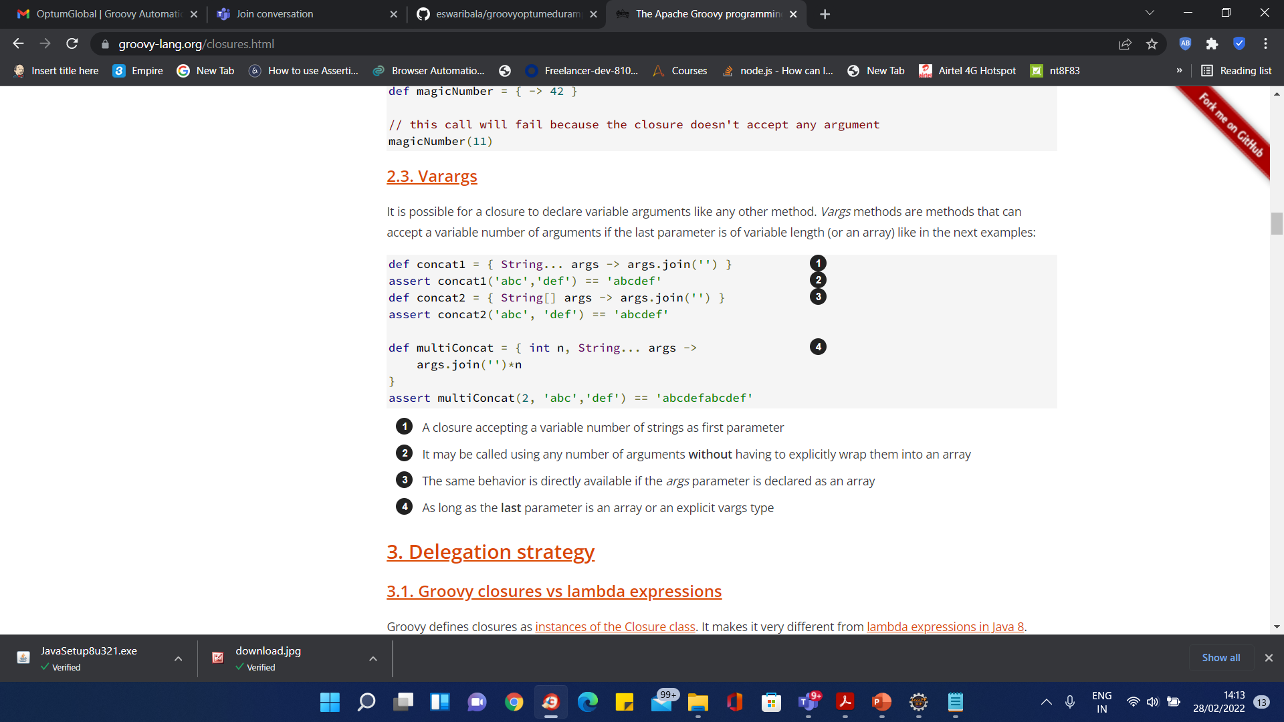
Varargs

Slide 83
Groovy Truth
Groovy evaluates conditions in if, while and for statements the same way as Java does for standard Java conditions : in Java you must provide a boolean expression and the result is the result of the evaluation.
In Groovy , the result is the same as in Java for those conditions.

Slide 84
Groovy Truth
The other truthfulness evaluation mechanism shown by examples can be summarized as:
numbers: a zero value evaluates to false, non zero to true.
objects: a null object reference evaluates to false, a non null reference to true.
Character : a character with a zero value evaluates to false, true otherwise.
String : a string evaluates to true if not null and not empty, false if null or empty (applies to GStrings and CharSequences too).
Collections and Maps (including subclasses List, Map, Set, HashSet ...) : also takes into account the size, evaluates to true if the collection is not null and not empty, false if null or empty.
Enumerations and Iterators evaluates to true if not null and they are some more elements (groovy evaluates hasMoreElements or hasNext on the object), false if null or no more elements.
Matcher : a matcher evaluates to true if there is at least one match, false if not match is found.
Closure : a closure evaluates to the evaluation of the result returned by the closure.

Slide 85
Groovy Truth
Broader than Java which just uses Boolean tests to determine truth.
Boolean | Corresponding boolean value is true
Matcher | The matcher has a match
Collection | The collection is non-empty
Map | Whether the map is non-empty
String | The string is non-empty
Number | The number is non-zero
None of the above | The object reference is non-null

Slide 86
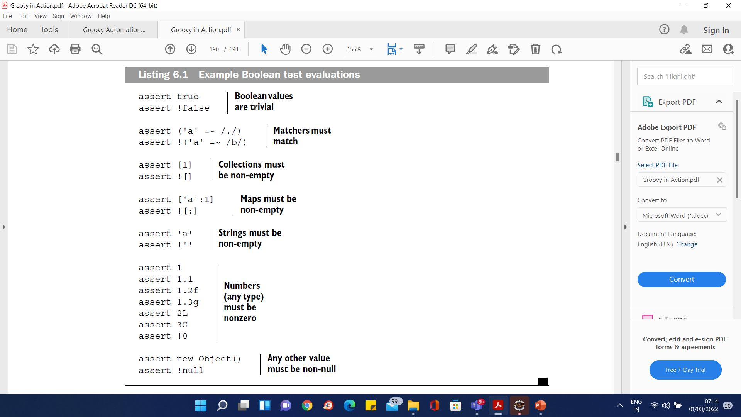
Groovy Truth

Slide 87
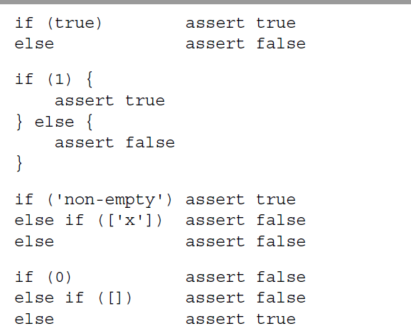
Groovy Truth

Slide 88
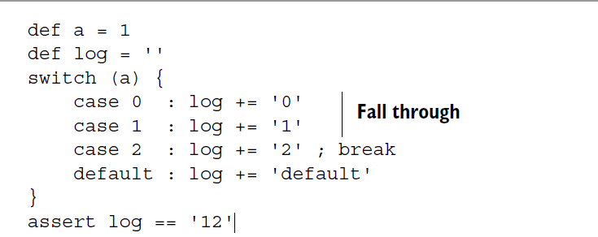
Groovy Truth

Slide 89
Switch Statement
An object that defines isCase method can be the candidate of a switch statement.
All of the standard Java classes have isCase defined.
Object | a.equals(b)
Class | a.isInstance(b)
Collection | a.contains(b)
Range | a.contains(b)
Pattern | a.matcher(b.toString()).matches()
String | (a==null && b==null) || a.equals(b)
Closure | a.call(b)

Slide 90
Switch Statement Example
switch (10)
{
case 0 : assert false ; break
case 0..9 : assert false ; break
case [8,9,11] : assert false ; break
case Float : assert false ; break
case {it%3 == 0}: assert false ; break
case ~/../ : assert true ; break
default : assert false ; break
}

Slide 91
Looping
Mostly the same as Java.
Standard Java for not supported.
Use for(x in 0..9) instead
Enhanced for loop, like Java 5 but uses in rather than ':' and doesn't requires lists to be templated.
In many cases, closures can be used instead.

Slide 92
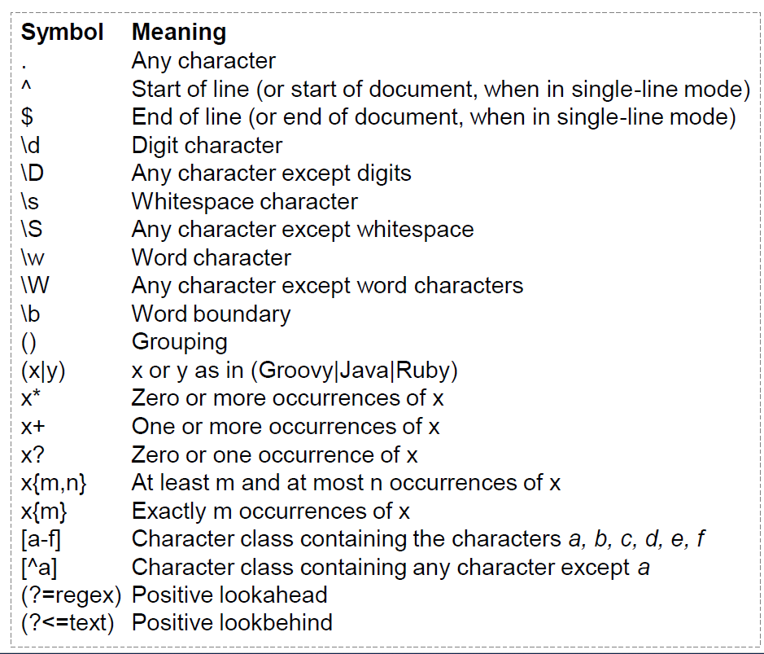
Regular Expression

Slide 93
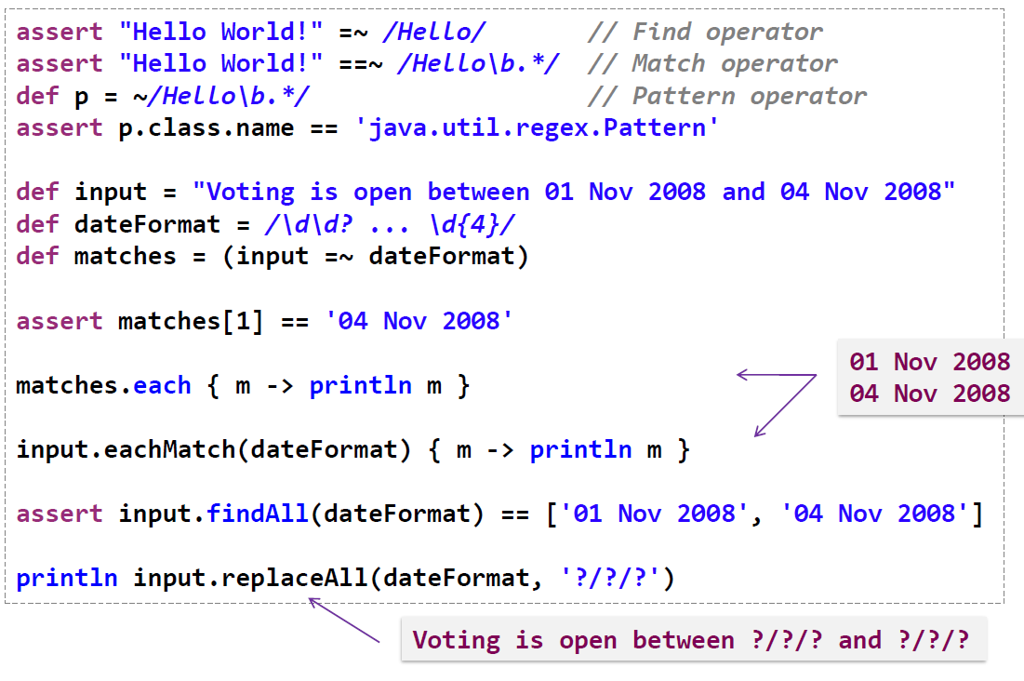
Regular Expression

Slide 94
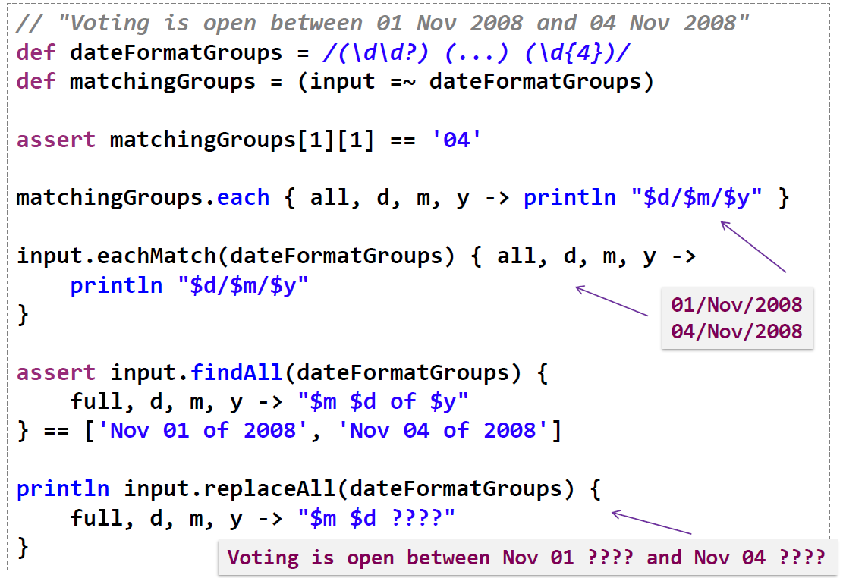
Regular Expression

Slide 95
Exceptions
Mostly the same as java with the following differences.
Declaration of exceptions in method signatures is optional. (Even for checked exceptions)
You therefore don't have to catch checked exceptions, they just go up the call stack

Slide 96
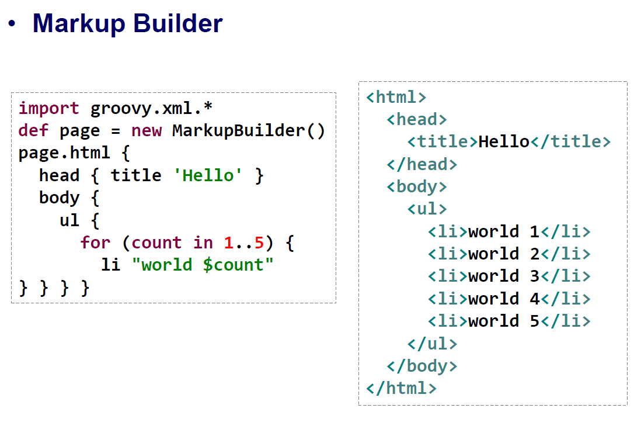
Markup Builder

Slide 97
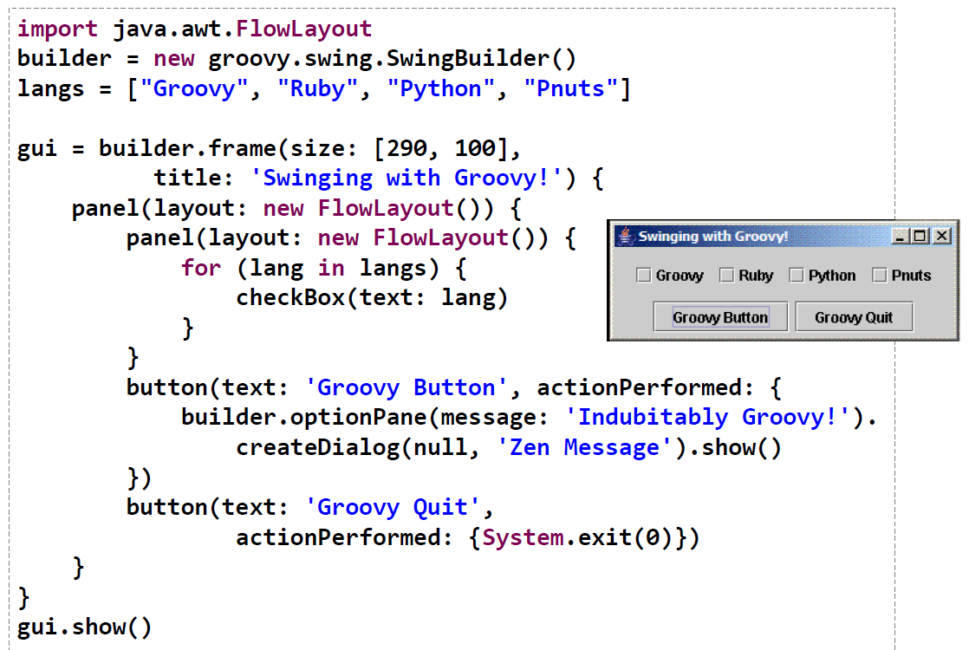
Swing Builder

Slide 98
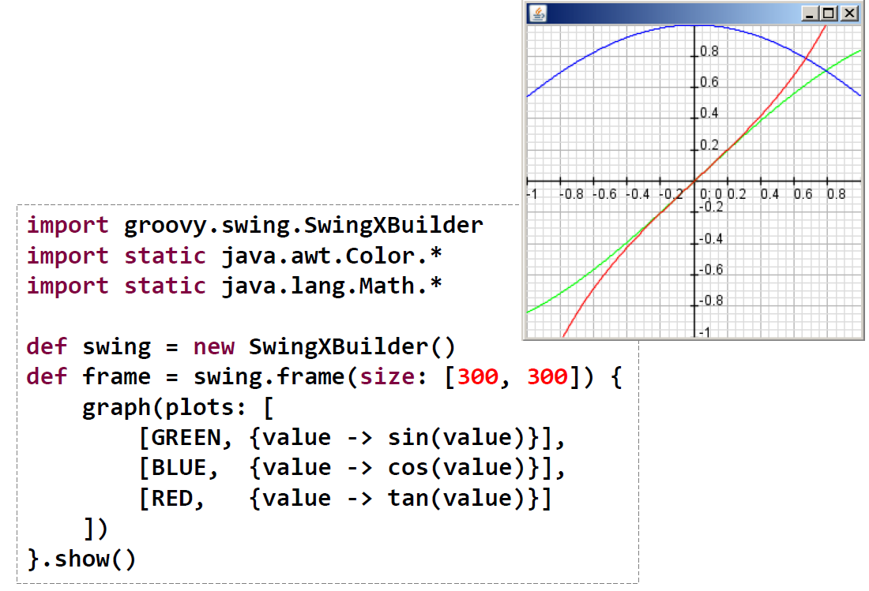
SwingX Builder

Slide 99
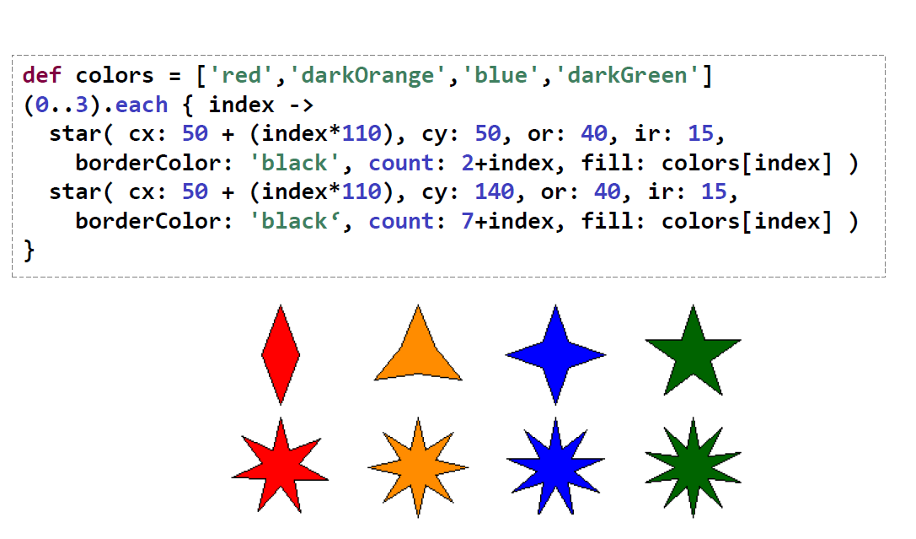
Graphics Builder

Slide 100
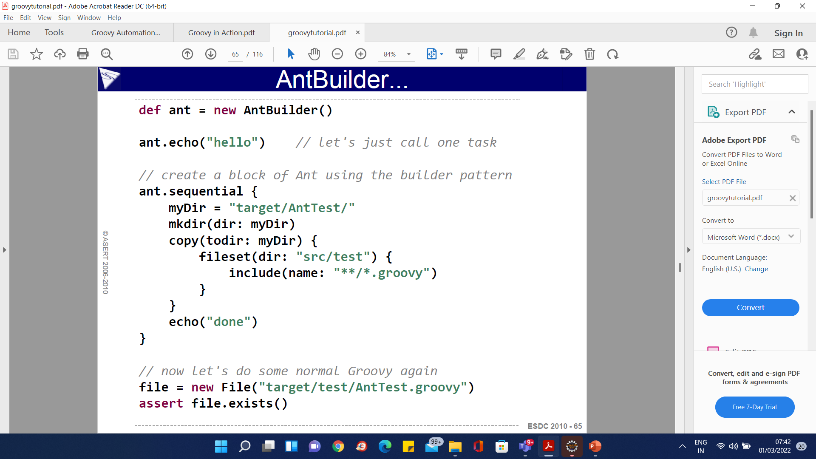
Ant Builder

Slide 101
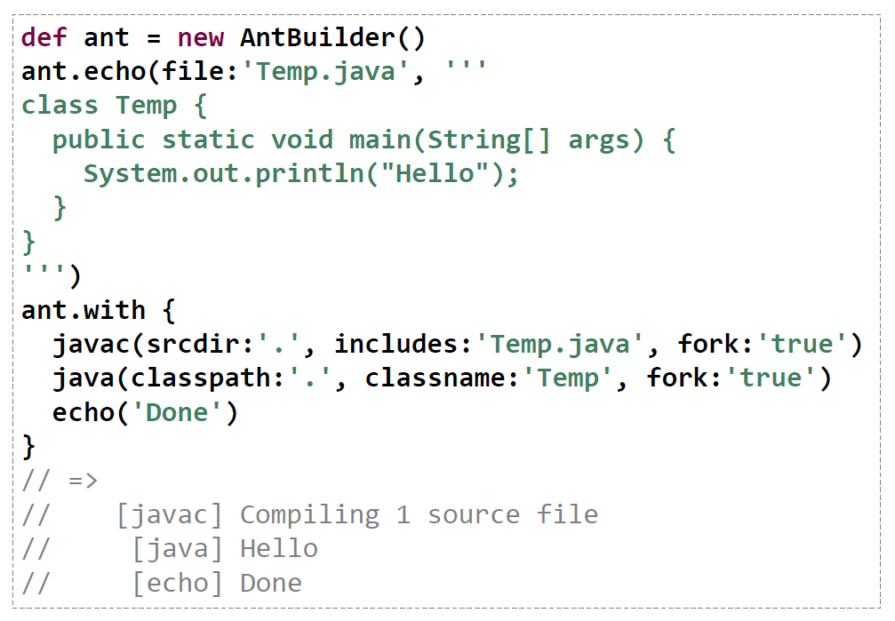
Ant Builder

Slide 102
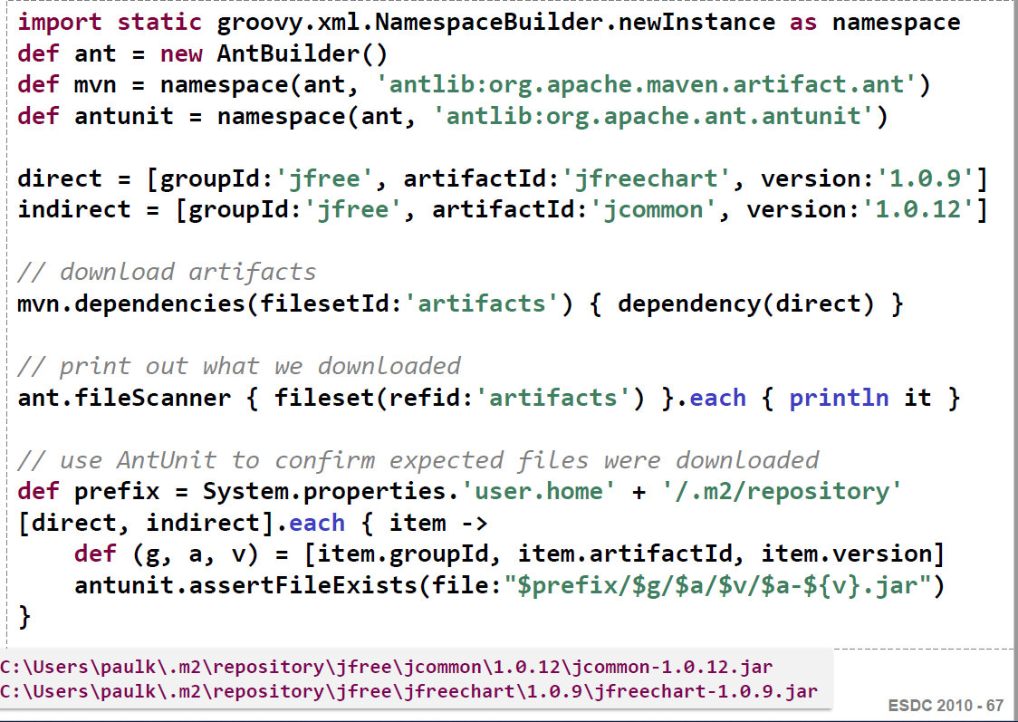
Ant Builder

Slide 103
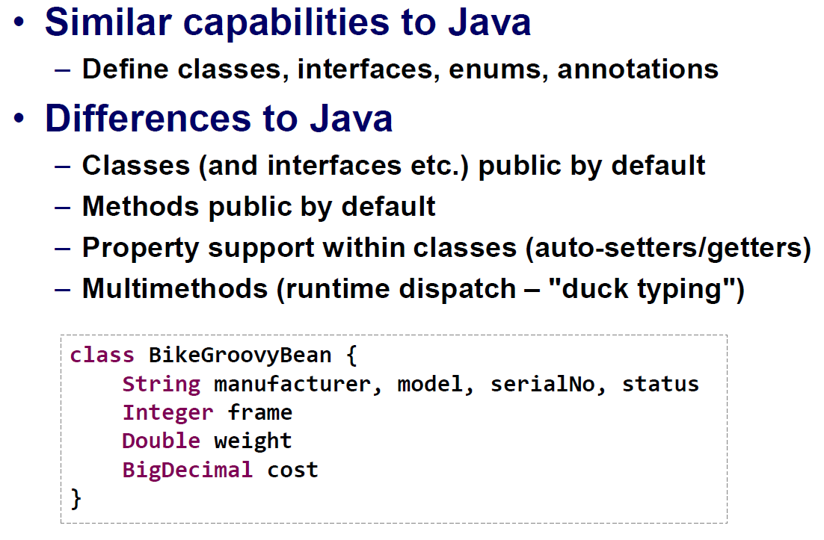
OOPS

Slide 104
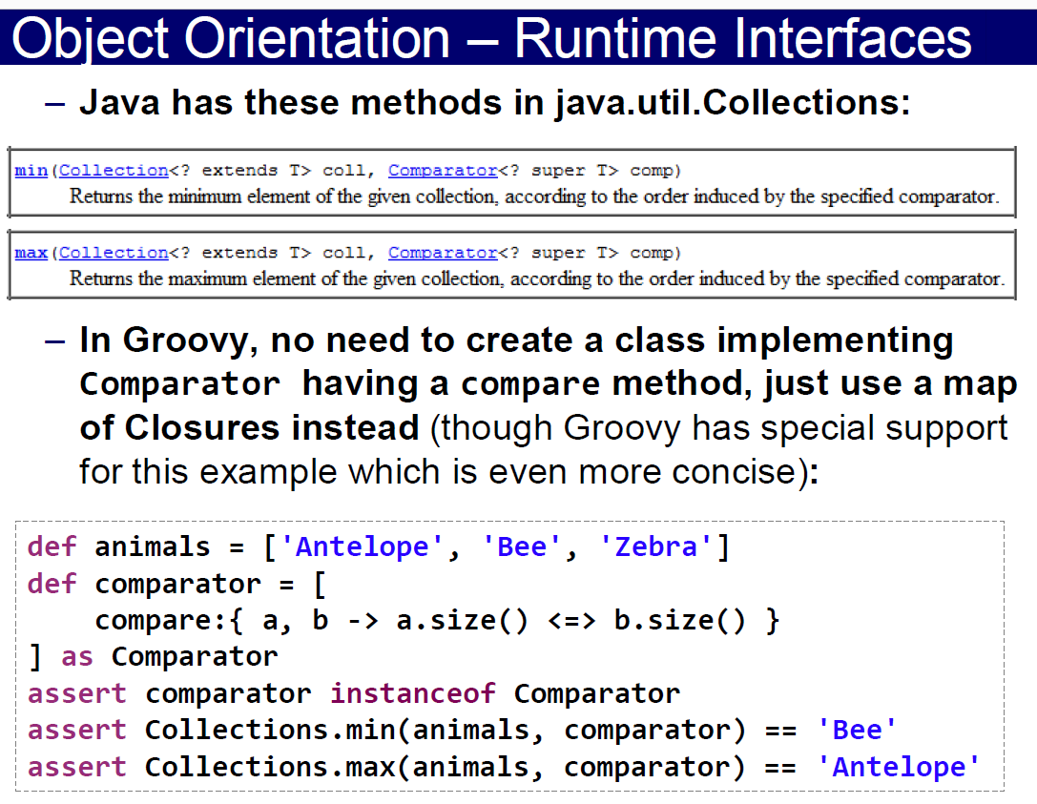
OOPS

Slide 105
Classes
Classes defined very much like in Java.
Public by default
Default visibility (not public, protected or private) will automatically adds bean methods.
Defining member variable type is optional however can't stand alone.
Fields can be referenced with subscript operator myclass['myfield']
Can also customize the field access operator '.' via get / set overrides.

Slide 106
Class – Field Access
class Counter {
public count = 0
}
def counter = new Counter()
// Using field access operator
counter.count = 1
// using subscript operator
def fieldName = 'count'
counter[fieldName] = 2

Slide 107

Class – Field Access

Slide 108
Class – Overriding Field Access
class PretendFieldCounter {
public count = 0
Object get (String name) { return 'pretend value' }
void set (String name, Object value) { count++ }
}
def pretender = new PretendFieldCounter()
// Call get method via overridden '.' operator
assert pretender.isNoField == 'pretend value'
// Call set method via overriden '.' operator
pretender.isNoFieldEither = 'just to increase counter'
assert pretender.count == 1

Slide 109
Method Declaration
Public by default
void returns can be omitted
Types in argument list can be omitted, Object assumed.
Dynamic dispatch used to resolve methods.
Defaults allowed in argument list.
Optionals parameters if last argument is Object[]
Common practice to use Maps for 'named' arguments.

Slide 110

Method Example

Slide 111

Method Example

Slide 112
Method Example
class Summer {
def sumWithDefaults(a, b, c=0) { return a + b + c }
def sumWithOptionals(a, b, Object[] optionals) {
return a + b + optionals.inject(0) { sum, i -> sum += i }
}
def sumNamed(Map args) {
['a','b','c'].each{ args.get( it, 0 ) }
return args.a + args.b + args.c
}
}
def summer = new Summer()
assert 2 == summer.sumWithDefaults(1,1)
assert 3 == summer.sumWithDefaults(1,1,1)
assert 2 == summer.sumWithOptionals(1,1)
assert 3 == summer.sumWithOptionals(1,1,1)
assert 2 == summer.sumNamed(a:1, b:1)
assert 1 == summer.sumNamed(c:1)

Slide 113
Safe Dereferencing
The ?. operator can be used to safely dereference member variables without worring about null pointer exceptions.
When the reference before that operator is a null reference, the evaluation of the current expression stops and null is returned.
def map = [a:[b:[c:1]]]
// Normal . operator
assert map.a.b.c == 1
// Safe dereferencing
assert map?.a?.x?.c == null

Slide 114
Constructors
emp = new Employee()
emp = new Employee(name: 'Bob', age: 32)
class Employee {
def name
def age
}
Public by default
If implicit can construct in 2 ways
Empty constructor
Named params
If explicit can construct in 3 ways
Traditional Java
Using as keyword
Implicit type conversion
emp = new Employee('Bob', 32)
emp2 = ['Joe', 41] as Employee
Employee emp3 = ['Tom', 50]
class Employee {
Employee(name, age) {
this.name = name; this.age = age
}
def name
def age
}

Slide 115

Constructors

Slide 116
.groovy Files
If a .groovy file contains no class, it becomes a class of type Script using the filename as the class name. main automatically added.
If it contains exactly one class with same name as file, then 1 to 1 relationship as in Java.
Can contain multiple classes of any visibility
Can mix scripting code and classes. No need to worry about ordering. Classes can be referenced before declared.
Groovy classloader will search for .groovy files on the classpath. Will only find classes where name matches file.

Slide 117
Imports
By default groovy imports the following packages into all .groovy files
import java.lang.*
import java.util.*
import java.io.*
import java.net.*
import groovy.lang.*
import groovy.util.*
import java.math.BigInteger
import java.math.BigDecimal
Import can be used for 'type aliasing' using as keyword
import thirdparty.Element as Element2

Slide 118
Multimethods
Groovy takes dynamic type of arguments into account when resolving methods. Java uses static type.
def oracle(Object o) { return 'object' }
def oracle(String o) { return 'string' }
Object x = 1
Object y = 'foo'
assert 'object' == oracle(x)
assert 'string' == oracle(y) // would return 'object' in Java

Slide 119
GroovyBeans
Allows property access for all JavaBeans, defined in Java or Groovy. (myclass.myproperty)
Auto Generates get / set methods for properties members in groovy classes if member variables have default visibility.
Also get / set only generated if you have not already defined an accessor. This allows you to create read only or write only properties.

Slide 120
GroovyBeans Example
class MyBean implements java.io.Serializable {
String foo, bar
// Make bar read only
String getBar() { return bar }
}
bean = new MyBean(foo: 'foo', bar: 'bar')
println bean.foo
bean.bar = 'error' // this won't be allowed
d = new Date()
println d.time // can access this as a property

Slide 121
GroovyBean Properties
All properties in a bean can be accessed with property semantics.
class SomeBean {
int var1
String var2
Date var3
}
def bean = new SomeBean(var1: 1, var2: "foo", var3: new Date());
bean.properties.each { println it.key + " = " + it.value }

Slide 122
Spread Dot Operator
'.*' use to access a property on each element in a list.
class Person {
Person(def name) { this.name = name }
def name
}
def list = [new Person('Bob'), new Person('Tom'),
new Person('Sal')]
// Java approach
for(Iterator i = list.iterator(); i.hasNext();)
System.out.println(((Person) i).getName());
// Closure
println list.collect{ p -> p?.name }
// Spread dot operator
println list*.name

Slide 123

GDK Methods File Management

Slide 124

GDK Methods Process Management

Slide 125

GDK Methods Process Management

Slide 126

GDK Methods Thread Management

Slide 127

Testing

Slide 128

Testing

Slide 129

XML Management

Slide 130

XML Management

Slide 131

XML Management

Slide 132

XML Management

Slide 133

XML Management

Slide 134

XML Management

Slide 135

Object Management

Slide 136

Object Management

Slide 137

SQL Connection

Slide 138

SQL Connection

Slide 139

SQL Connection

Slide 140

SQL Data Access

Slide 141

SQL Data Access

Slide 142

SQL Data Access

Slide 143
GPath
GPath is a construction in Groovy code that powers object navigation, analogous to XPath
Builds upon bean properties, closures, safe dereferencing operator and spread dot operator.
// Find all the 'get' methods in this class
println this.class.methods*.name.grep(~/get.*/).sort()
// Output
[getBinding, getClass, getMetaClass, getProperty]

Slide 144
GPath Example2
Given the following model
class Invoice { List items; Date date }
class LineItem {
Product product; int count;
int total() {
return product.dollar * count
}
}
class Product { String name; def dollar}

Slide 145
GPath Example2
You can perform GPath operations like the following.
// get the totals of all line items in all invoices
invoices.items*.total()
// find all product names with a line item totals > 7000
invoices.items.grep{it.total() > 7000}.product.name

Slide 146
Mix In Categories
'use' keyword
Allows you to augment a class's available instance methods.
class Person {
Person(name, male) { this.name = name; this.male = male}
private def name
boolean male
}
// Add getTitle method to Person class
class PersonTitleCategory {
static String getTitle(Person self) {
if(self.male)
return 'Mr. ' + self.name
else
return 'Ms. ' + self.name
}
}

Slide 147
Mix In Categories
kim = new Person('Kim', false);
bob = new Person('Bob', true);
println kim.name
println bob.name
use (PersonTitleCategory) {
println kim.title
println bob.title
}
Output:
Kim
Bob
Ms. Kim
Mr. Bob

Slide 148
What is Grails?
Grail is an open-source web application framework that uses the Apache Groovy programming language to develop real projects.
It is a plug-in-based framework that uses its build system-(Gant) but plans to migrate to Gradle.
The Grails homepage provides numerous pre-defined plugins which extend the Grails framework.
The Grails framework allows for instance development without requiring any configuration.
Grails uses JavaEE as the structural basis and Spring for structuring the application via dependency injection.

Slide 149
Features of Grails
Grails framework is opted by the startup organizations to launch the product from the development mode to production mode.
It ensures a different way of creating web apps to the standard Java mechanisms of servlet programming, Java Server Faces, JSPs, etc.

Slide 150
Features of Grails
Smart Coding
Vibrant and Supportive Community
Grails Scaffolding
Compatibility
Extensive Plugins
Minimal Server Restart
Shorter Learning Curve
https://guides.grails.org/creating-your-first-grails-app/guide/index.html

Slide 151
Difference between Grails and Groovy
Groovy | Grails
Groovy is an object-oriented programming language for the Java platform. | Grails (previously known as “Groovy on Grails”) is a programming framework based on Groovy and inspired by Ruby on Rails.
All groovy codes are compiled to Java byte codes which can be executed by JVM. | It’s a RAPID Web Application development framework which provides a tremendous boost in development by abstracting its common requirements in web development.
Groovy has a Java-like syntax and works seamlessly with Java bytecode. | Grail uses Spring , hibernate and a bunch of other libraries.
All groovy codes are compiled to Java byte codes which can be executed by JVM. | Grail is the advanced version of Groovy.

Slide 152

Grails MVC

Slide 153


Grails Framework

Slide 154

Grails Framework

Slide 155

Grails Framework

Slide 156

Grails Framework

Slide 157

Grails Framework

Slide 158

Grails Framework

Slide 159

Grails Framework

Slide 160

Grails Framework

Slide 161

Grails Framework

Slide 162

Grails Framework

Slide 163
Anatomy of a Spock Specification
Spock tests can be written for any language that runs on JVM.
This means that even if your application code is in Java or Scala or Kotlin etc., you can still choose to write your unit/integration tests in Spock (over others like JUnit, JBehave, etc.).
Spock test classes are called “Specifications” (Similar to Specs in BDD world) and you can extend the “Specification” class of the Spock framework. (Specification is the base class of the Spock framework).

Slide 164
Anatomy of a Spock Specification
Each Spec file can contain multiple tests (similar to a JUnit test class file) and each test can optionally contain the BDD blocks i.e. given, when and then.
This is similar to other BDD frameworks, where each of these sections can be correlated to Arrange, Act and Assert sections in the JUnit tests respectively.

Slide 165

Anatomy of a Spock Specification

Slide 166
Questions

Slide 167
Module Summary
In this module we discussed
Overview of Groovy
Groovy Installation
Groovy vs Java
Data Types
Groovy Collections

